Slide 1
Chapter 3 Introduction to Classes, Objects, Methods and Strings
Java How to Program, 11/e
Questions? E-mail paul.deitel@deitel.com

Slide 2
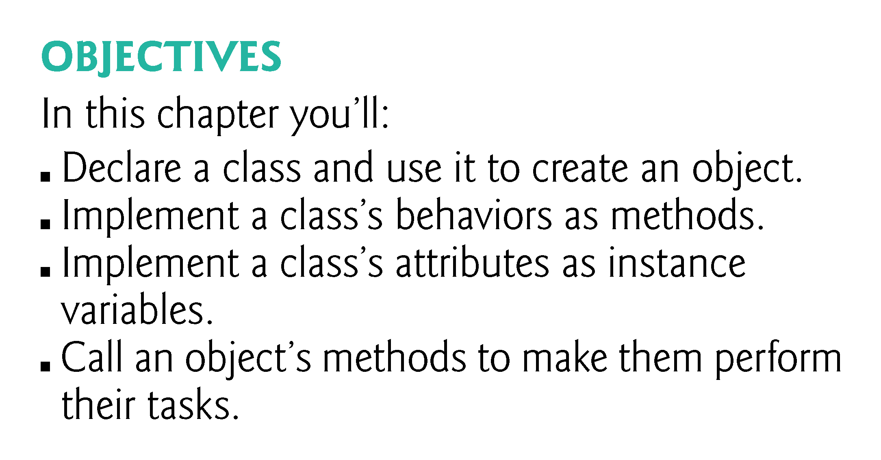

Slide 3
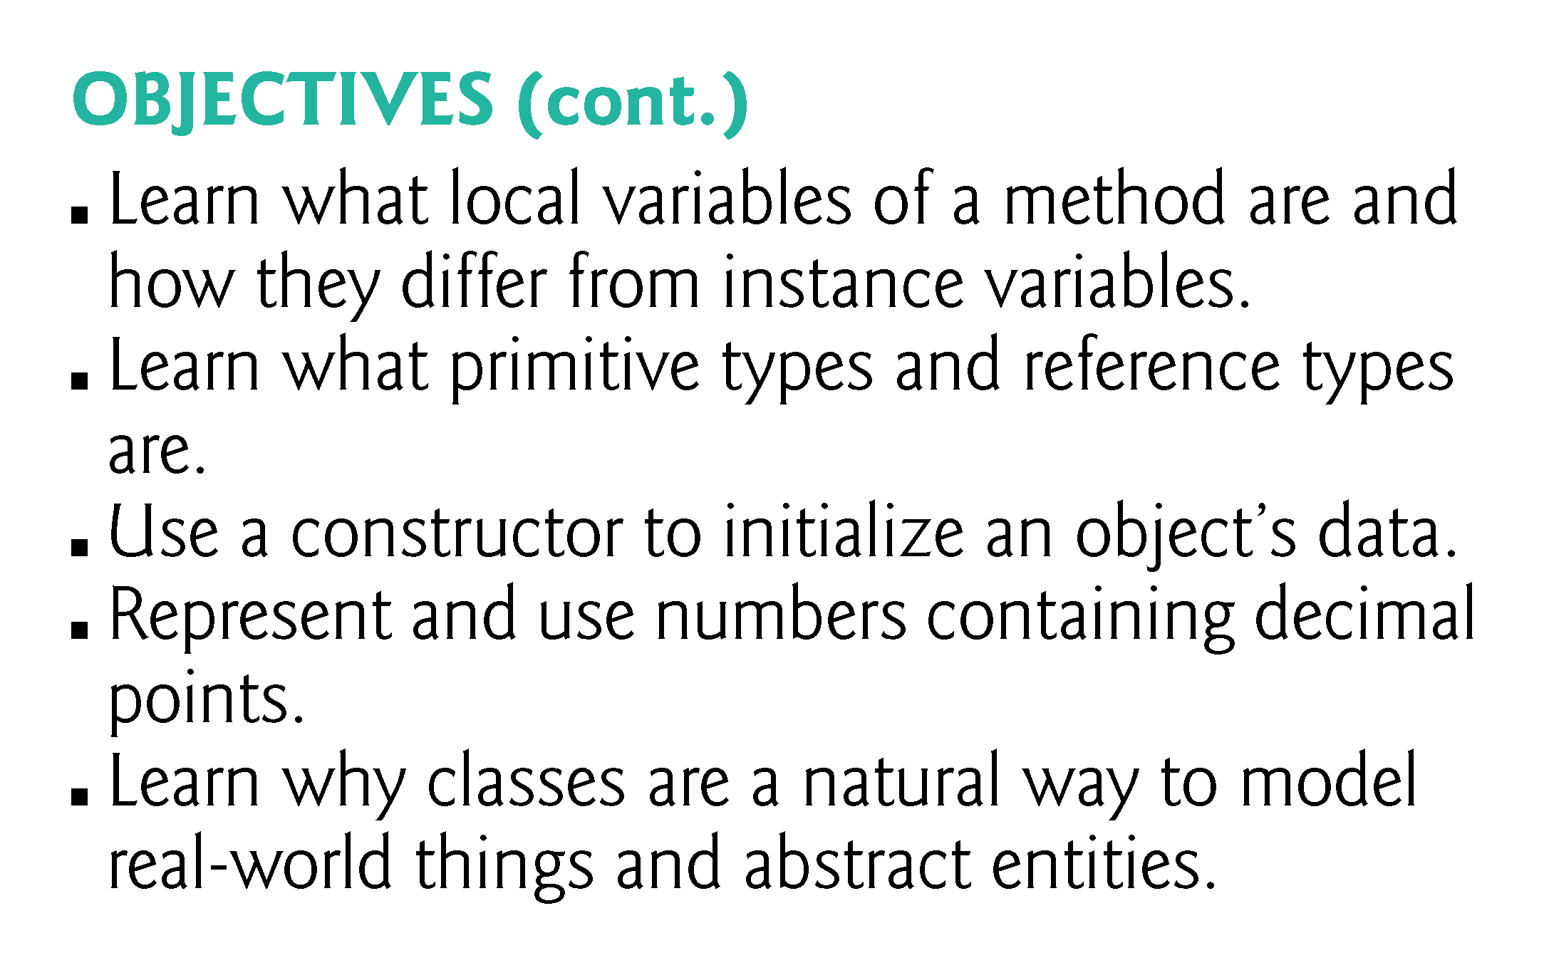

Slide 4
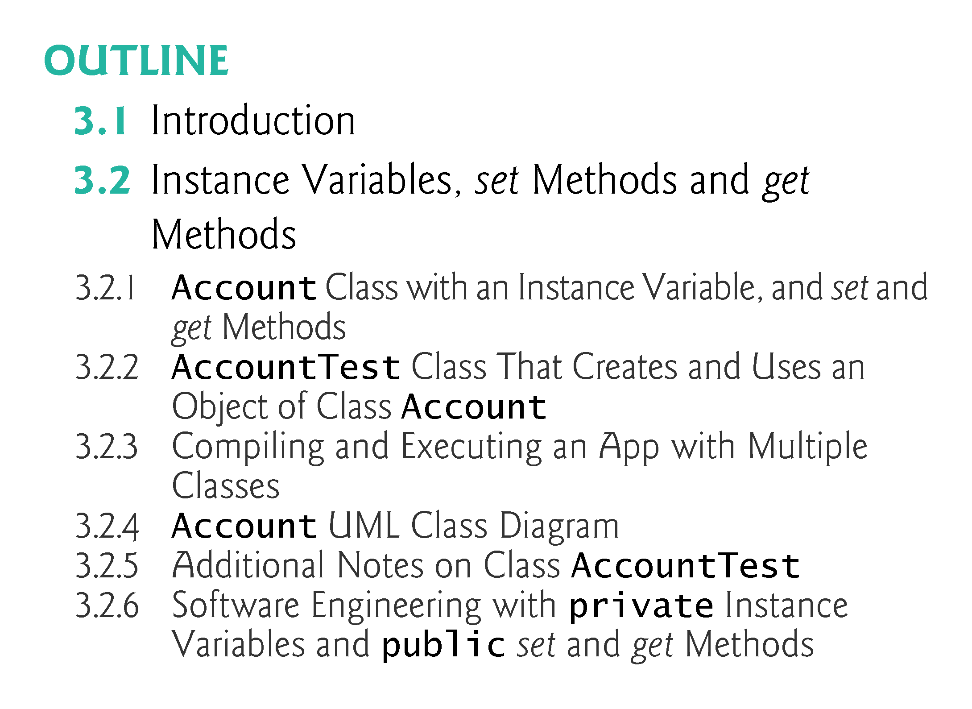

Slide 5
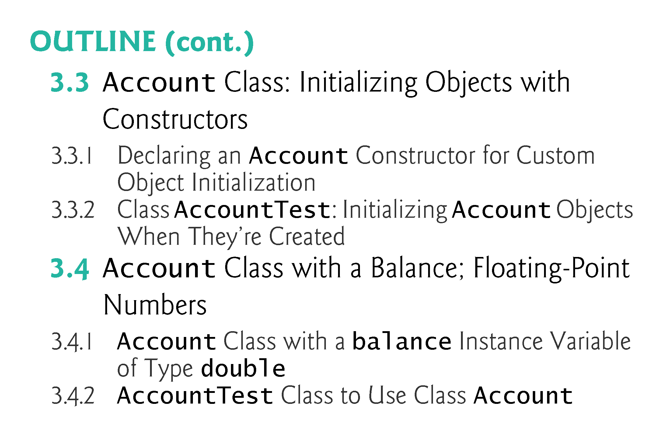

Slide 6
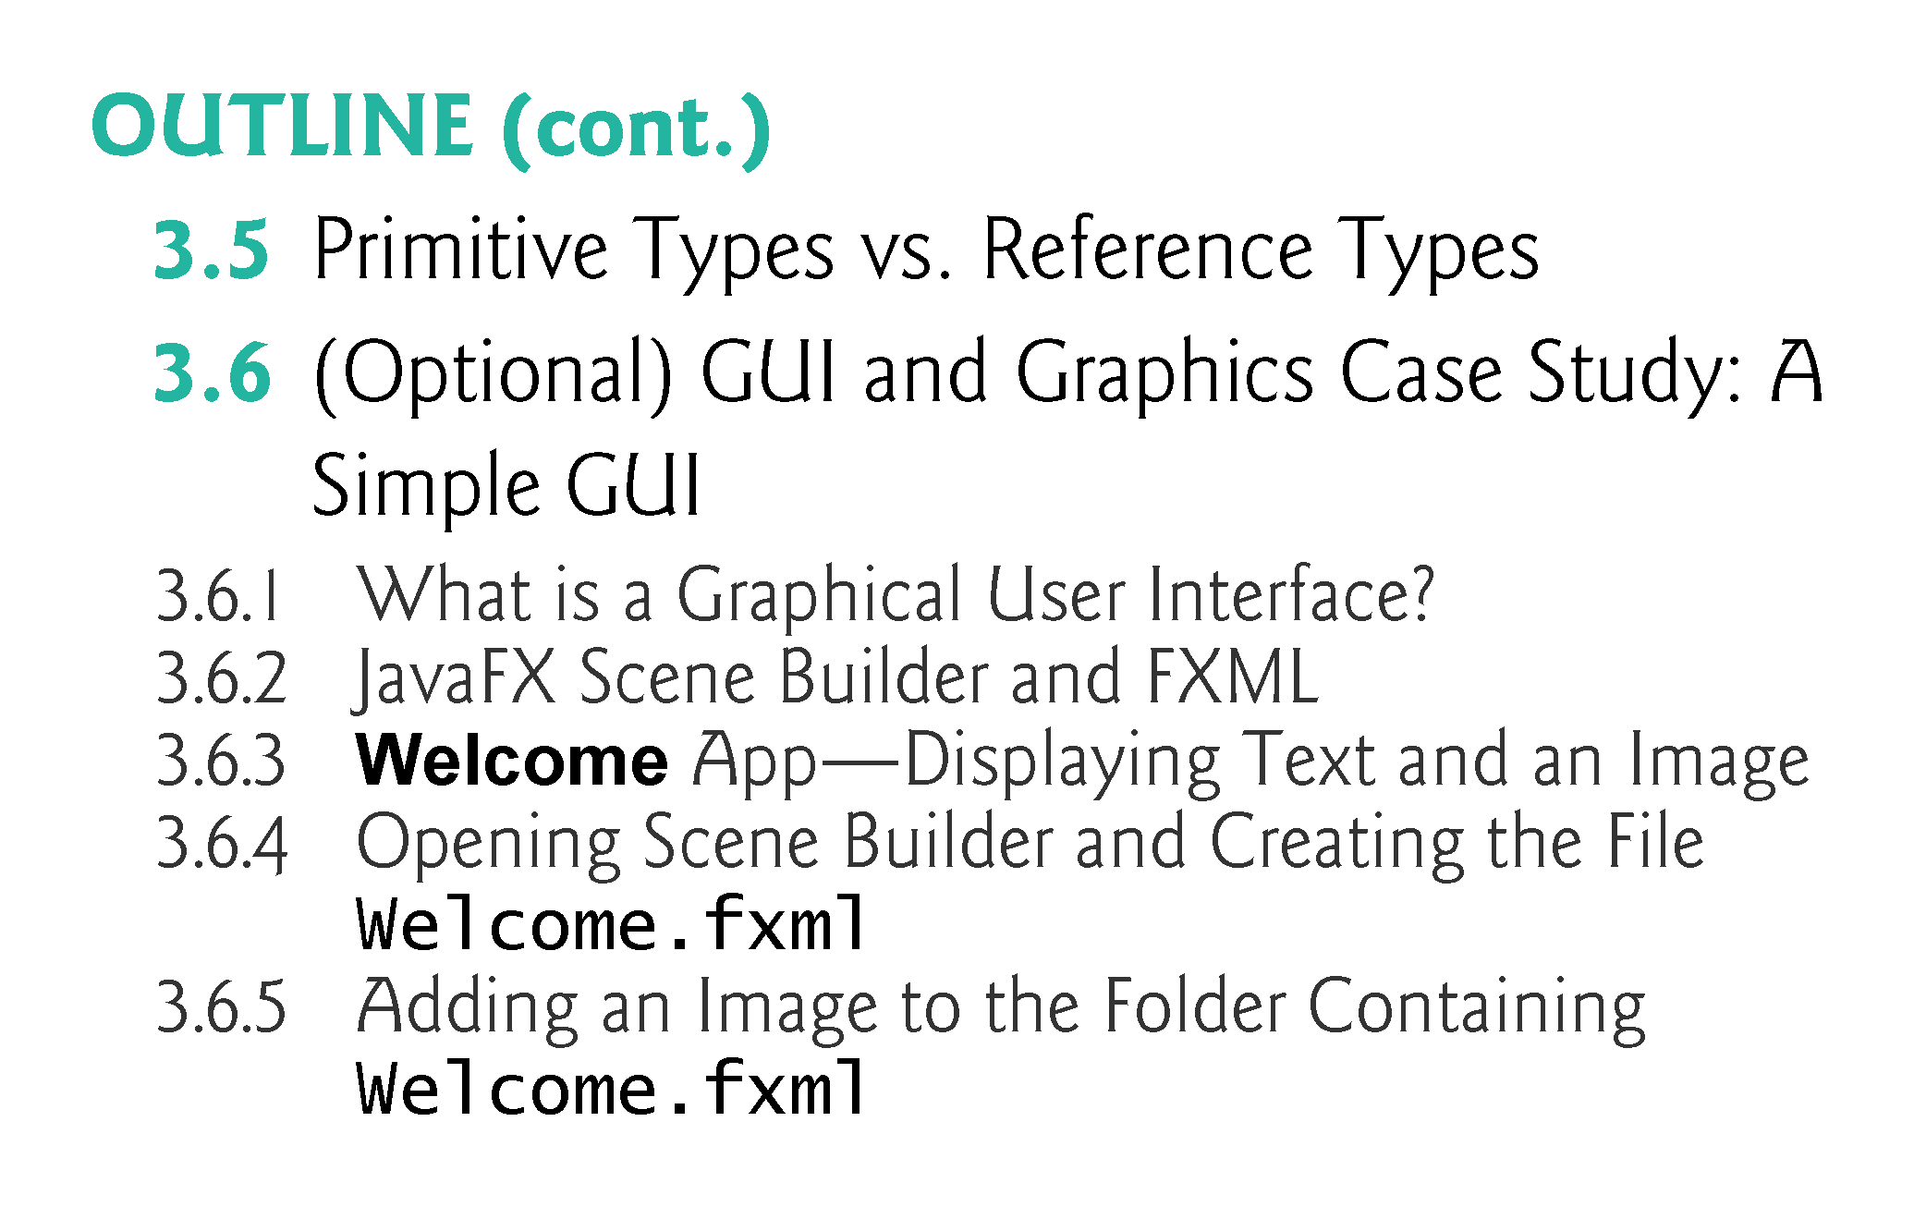

Slide 7
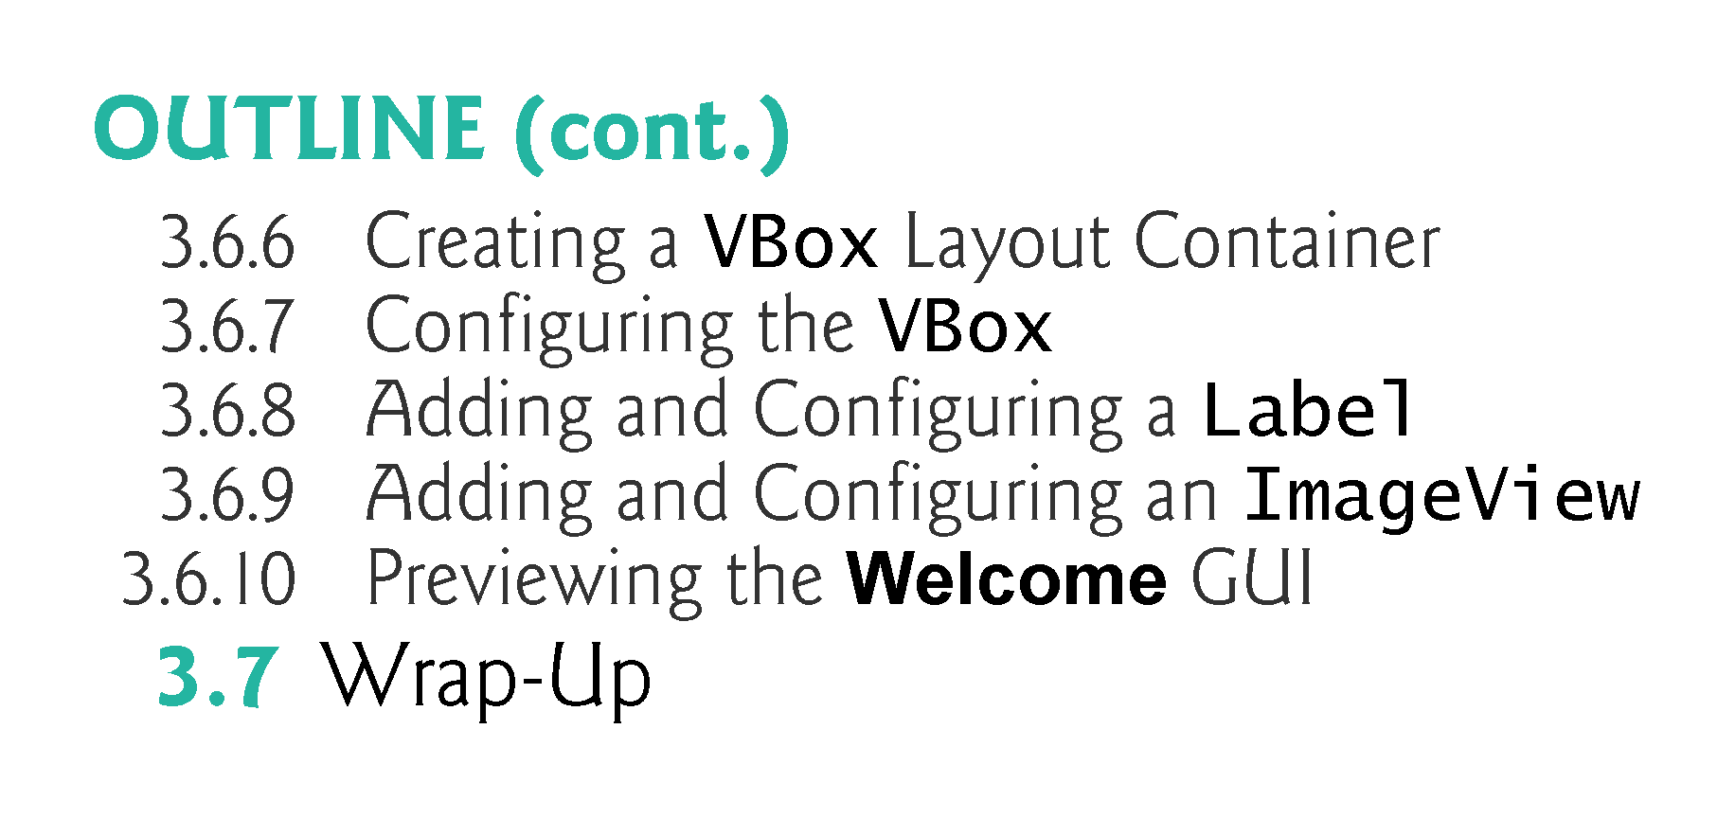

Slide 8
3.2 Instance Variables, set Methods and get Methods
Each class you create becomes a new type that can be used to declare variables and create objects.
You can declare new classes as needed; this is one reason Java is known as an extensible language.

Slide 9
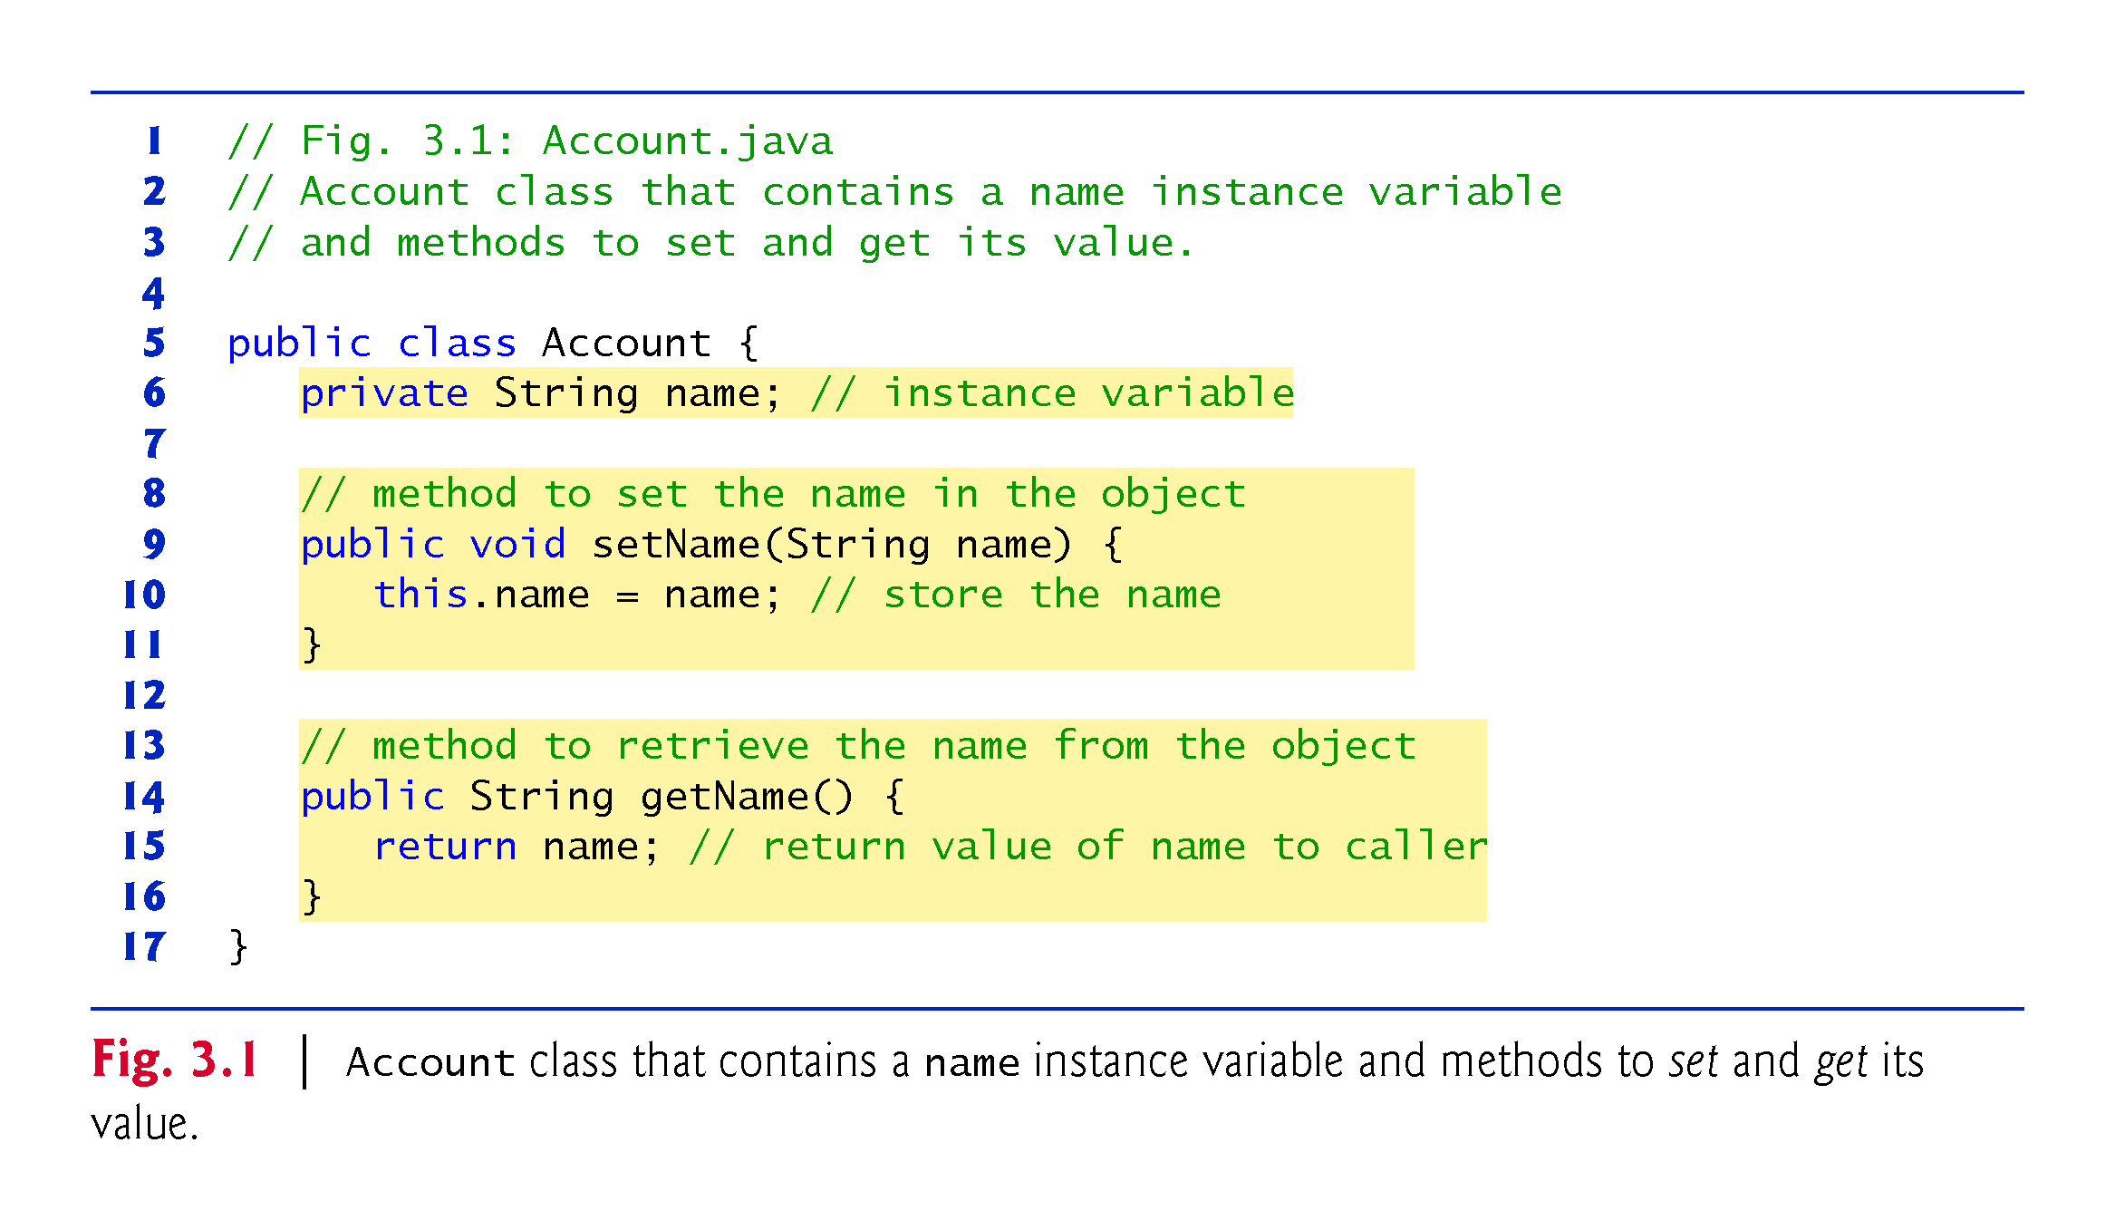

Slide 10
3.2.1 Account Class with an Instance Variable, a set Method and a get Method (Cont.)
Class Declaration
Each class declaration that begins with the access modifier public must be stored in a file that has the same name as the class and ends with the .java filename extension.
Every class declaration contains keyword class followed immediately by the class’s name.

Slide 11
3.2.1 Account Class with an Instance Variable, a set Method and a get Method (Cont.)
Identifiers and Camel Case Naming
Class, method and variable names are identifiers.
By convention all use camel case names.
Class names begin with an uppercase letter, and method and variable names begin with a lowercase letter.

Slide 12
3.2.1 Account Class with an Instance Variable, a set Method and a get Method (Cont.)
Instance Variable name
An object has attributes that are implemented as instance variables and carried with it throughout its lifetime.
Instance variables exist before methods are called on an object, while the methods are executing and after the methods complete execution.
A class normally contains one or more methods that manipulate the instance variables that belong to particular objects of the class.
Instance variables are declared inside a class declaration but outside the bodies of the class’s method declarations.
Each object (instance) of the class has its own copy of each of the class’s instance variables.

Slide 13
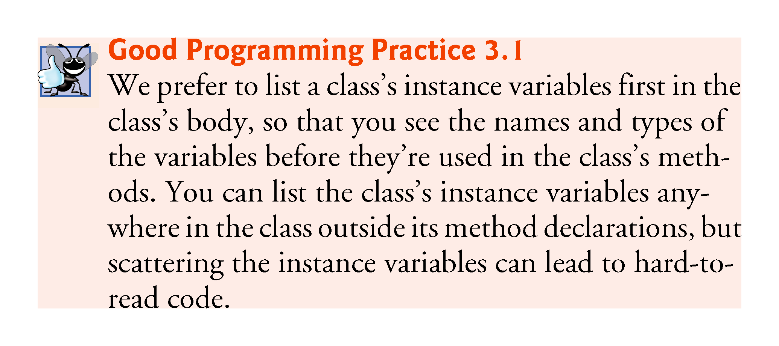

Slide 14
3.2.1 Account Class with an Instance Variable, a set Method and a get Method (Cont.)
Access Modifiers public and private
Most instance-variable declarations are preceded with the keyword private, which is an access modifier.
Variables or methods declared with access modifier private are accessible only to methods of the class in which they’re declared.

Slide 15
3.1.1 Account Class with an Instance Variable, a set Method and a get Method (Cont.)
setName Method of Class Account
Parameters are declared in a comma-separated parameter list, which is located inside the parentheses that follow the method name in the method declaration.
Multiple parameters are separated by commas.
Each parameter must specify a type followed by a variable name.

Slide 16
3.1.1 Account Class with an Instance Variable, a set Method and a get Method (Cont.)
Parameters Are Local Variables
Variables declared in the body of a particular method are local variables and can be used only in that method.
When a method terminates, the values of its local variables are lost.
A method’s parameters are local variables of the method.

Slide 17
3.1.1 Account Class with an Instance Variable, a set Method and a get Method (Cont.)
setName Method Body
Every method’s body is delimited by left and right braces ({ and }).
Each method’s body contains one or more statements that perform the method’s task(s).

Slide 18
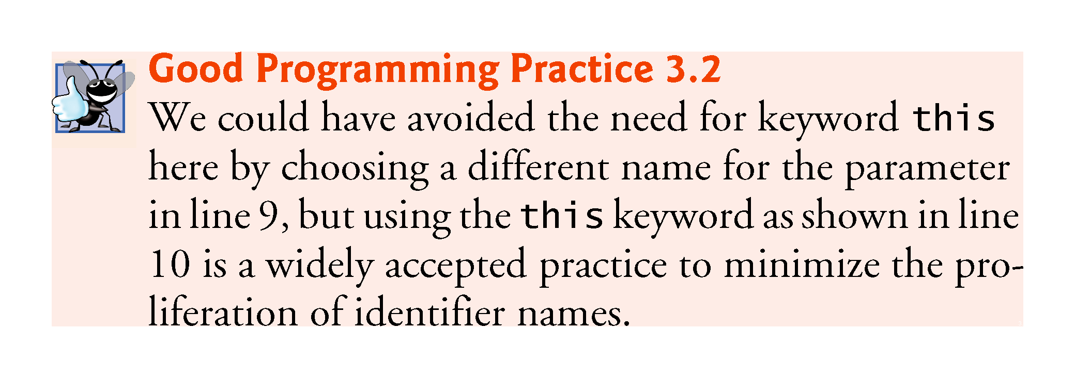

Slide 19
3.2.1 Account Class with an Instance Variable, a set Method and a get Method (Cont.)
getName Method of Class Account
The method’s return type specifies the type of data returned to a method’s caller.
Keyword void indicates that a method will perform a task but will not return any information.
Empty parentheses following a method name indicate that the method does not require any parameters to perform its task.
When a method that specifies a return type other than void is called and completes its task, the method must return a result to its calling method.

Slide 20
3.2.1 Account Class with an Instance Variable, a set Method and a get Method (Cont.)
The return statement passes a value from a called method back to its caller.
Classes often provide public methods to allow the class’s clients to set or get private instance variables.
The names of these methods need not begin with set or get, but this naming convention is recommended.

Slide 21
3.2.2 AccountTest Class That Creates and Uses an Object of Class Account
Driver Class AccountTest
A class that creates an object of another class, then calls the object’s methods, is a driver class.

Slide 22
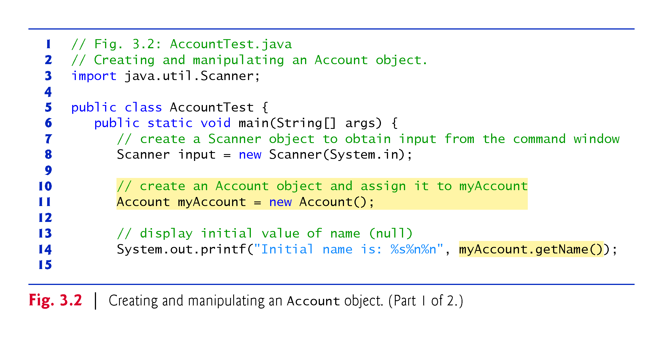

Slide 23
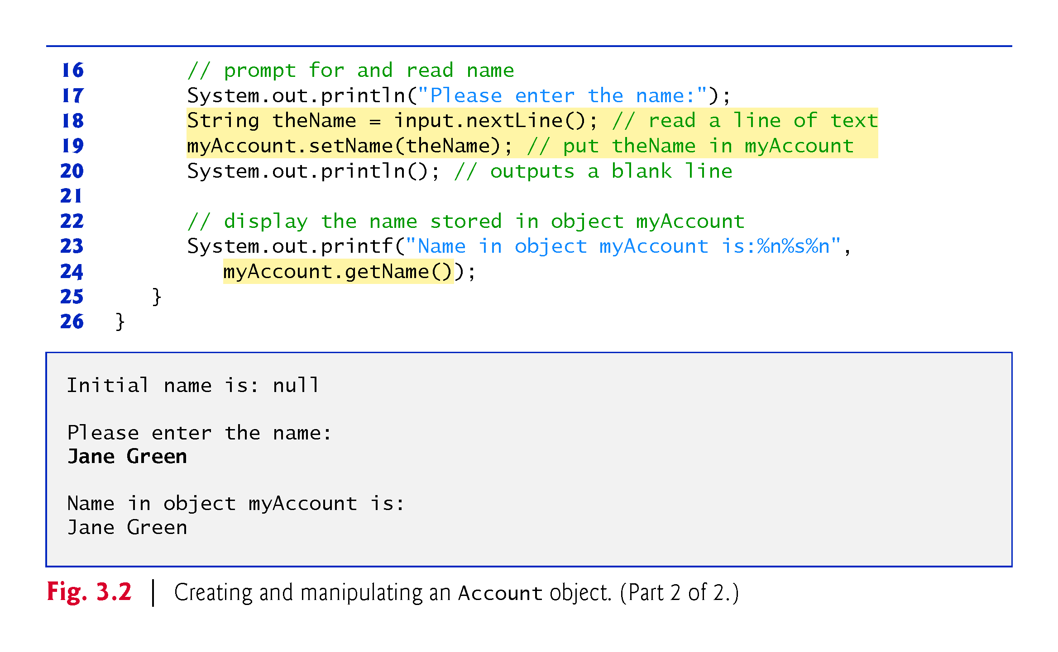

Slide 24
3.2.2 AccountTest Class That Creates and Uses an Object of Class Account (Cont.)
Scanner Object for Receiving Input from the User
Scanner method nextLine reads characters until a newline character is encountered, then returns the characters as a String.
Scanner method next reads characters until any white-space character is encountered, then returns the characters as a String.

Slide 25
3.2.2 AccountTest Class That Creates and Uses an Object of Class Account (Cont.)
Instantiating an Object—Keyword new and Constructors
A class instance creation expression begins with keyword new and creates a new object.
A constructor is similar to a method but is called implicitly by the new operator to initialize an object’s instance variables at the time the object is created.

Slide 26
3.2.2 AccountTest Class That Creates and Uses an Object of Class Account (Cont.)
Calling Class Account’s getName Method
To call a method of an object, follow the object name with a dot separator, the method name and a set of parentheses containing the method’s arguments.

Slide 27
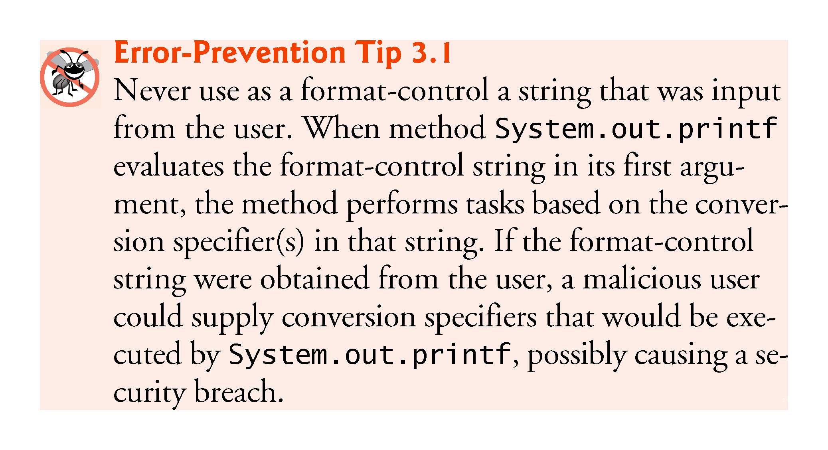

Slide 28
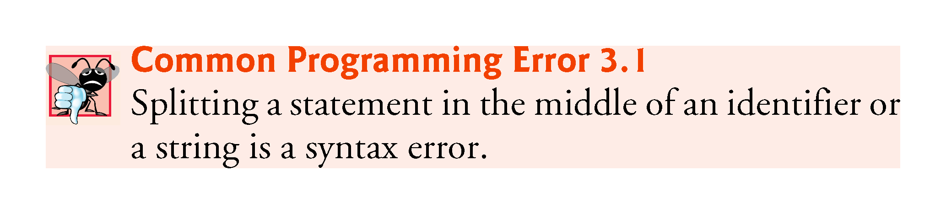

Slide 29
3.2.2 AccountTest Class That Creates and Uses an Object of Class Account (Cont.)
null—the Default Initial Value for String Variables
Local variables are not automatically initialized.
Every instance variable has a default initial value—a value provided by Java when you do not specify the instance variable’s initial value.
The default value for an instance variable of type String is null.

Slide 30
3.2.2 AccountTest Class That Creates and Uses an Object of Class Account (Cont.)
Calling Class Account’s setName Method
A method call supplies values—known as arguments—for each of the method’s parameters.
Each argument’s value is assigned to the corresponding parameter in the method header.
The number of arguments in a method call must match the number of parameters in the method declaration’s parameter list.
The argument types in the method call must be consistent with the types of the corresponding parameters in the method’s declaration.

Slide 31
3.2.3 Compiling and Executing an App with Multiple Classes
The javac command can compile multiple classes at once.
Simply list the source-code filenames after the command with each filename separated by a space from the next.
If the directory containing the app includes only one app’s files, you can compile all of its classes with the command javac *.java.
The asterisk (*) in *.java indicates that all files in the current directory ending with the filename extension “.java” should be compiled.

Slide 32
3.2.4 Account UML Class Diagram
Top Compartment
In the UML, each class is modeled in a class diagram as a rectangle with three compartments. The top one contains the class’s name centered horizontally in boldface.

Slide 33
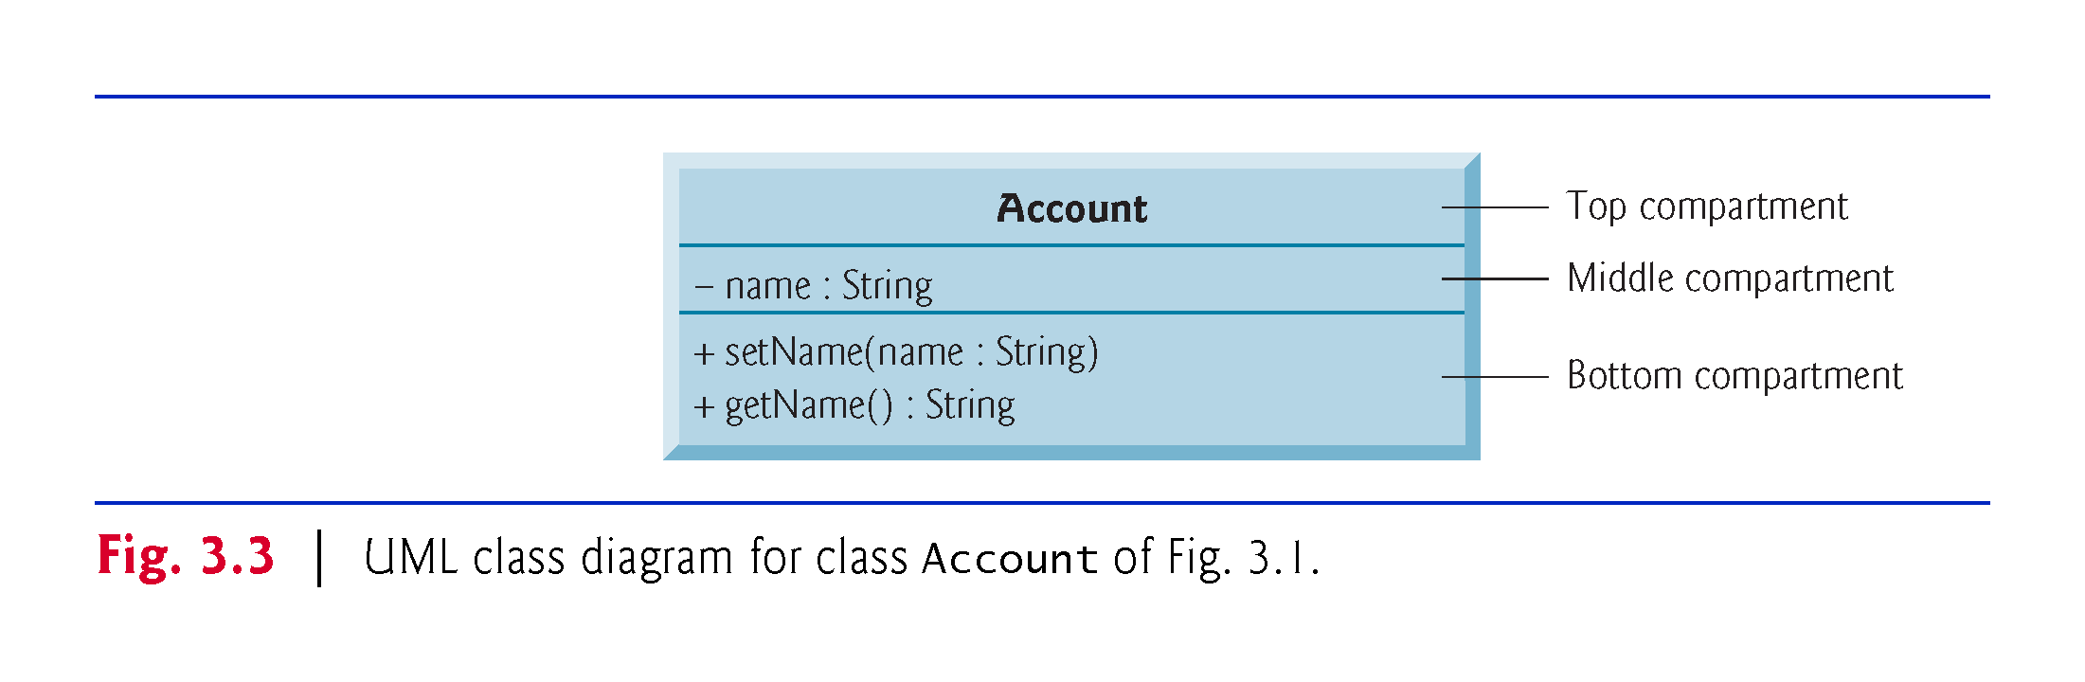

Slide 34
3.2.4 Account UML Class Diagram
Middle Compartment
The middle compartment contains the class’s attributes, which correspond to instance variables in Java.

Slide 35
3.2.4 Account UML Class Diagram
Bottom Compartment
The bottom compartment contains the class’s operations, which correspond to methods and constructors in Java.
The UML represents instance variables as an attribute name, followed by a colon and the type.
Private attributes are preceded by a minus sign (–) in the UML.
The UML models operations by listing the operation name followed by a set of parentheses.
A plus sign (+) in front of the operation name indicates that the operation is a public one in the UML (i.e., a public method in Java).

Slide 36
3.2.4 Account UML Class Diagram
Return Types
The UML indicates an operation’s return type by placing a colon and the return type after the parentheses following the operation name.
UML class diagrams do not specify return types for operations that do not return values.
Declaring instance variables private is known as data hiding or information hiding.

Slide 37
3.2.4 Account UML Class Diagram
Parameters
The UML models a parameter of an operation by listing the parameter name, followed by a colon and the parameter type between the parentheses after the operation name

Slide 38
3.2.5 Additional Notes on Class AccountTest
static Method main
You must call most methods other than main explicitly to tell them to perform their tasks.
A key part of enabling the JVM to locate and call method main to begin the app’s execution is the static keyword, which indicates that main is a static method that can be called without first creating an object of the class in which the method is declared.

Slide 39
3.2.5 Additional Notes on Class AccountTest (Cont.)
Notes on import Declarations
Most classes you’ll use in Java programs must be imported explicitly.
There’s a special relationship between classes that are compiled in the same directory.
By default, such classes are considered to be in the same package—known as the default package.
Classes in the same package are implicitly imported into the source-code files of other classes in that package.

Slide 40
3.2.5 Additional Notes on Class AccountTest (Cont.)
An import declaration is not required when one class in a package uses another in the same package.
An import- declaration is not required if you always refer to a class with its fully qualified class name, which includes its package name and class name.

Slide 41
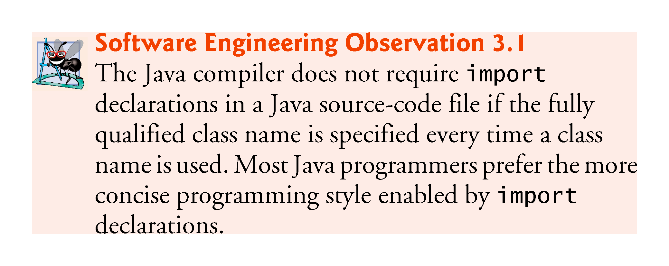

Slide 42
3.2.6 Software Engineering with private Instance Variables and public set and get Methods
Declaring instance variables private is known as data hiding or information hiding.

Slide 43
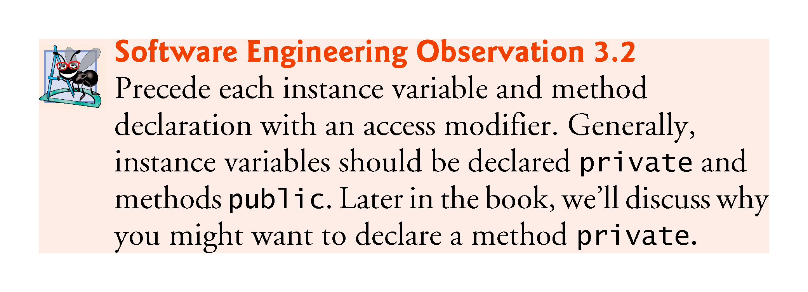

Slide 44
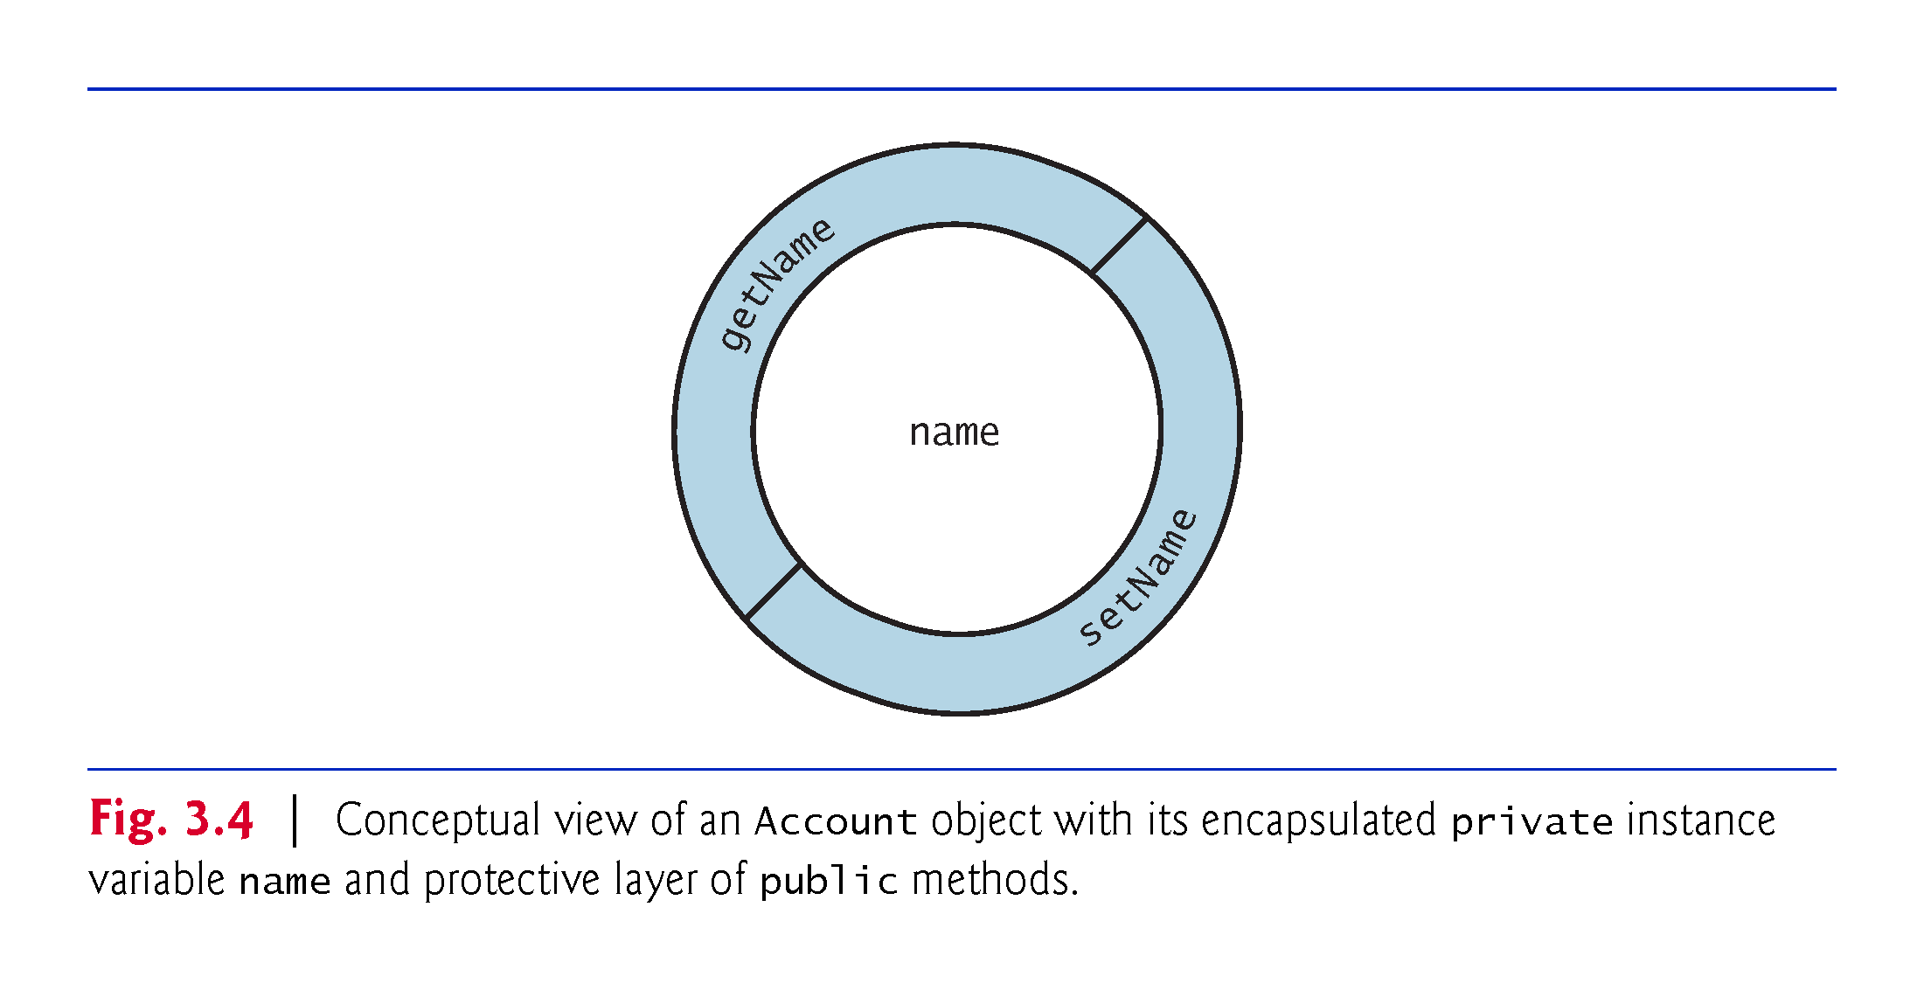
3.2.6 Software Engineering with private Instance Variables and public set and get Methods

Slide 45
3.3 Account Class: Initializing Objects with Constructors
Each class you declare can optionally provide a constructor with parameters that can be used to initialize an object of a class when the object is created.
Java requires a constructor call for every object that’s created.

Slide 46
3.3.1 Declaring an Account Constructor for Custom Object Initialization

Slide 47
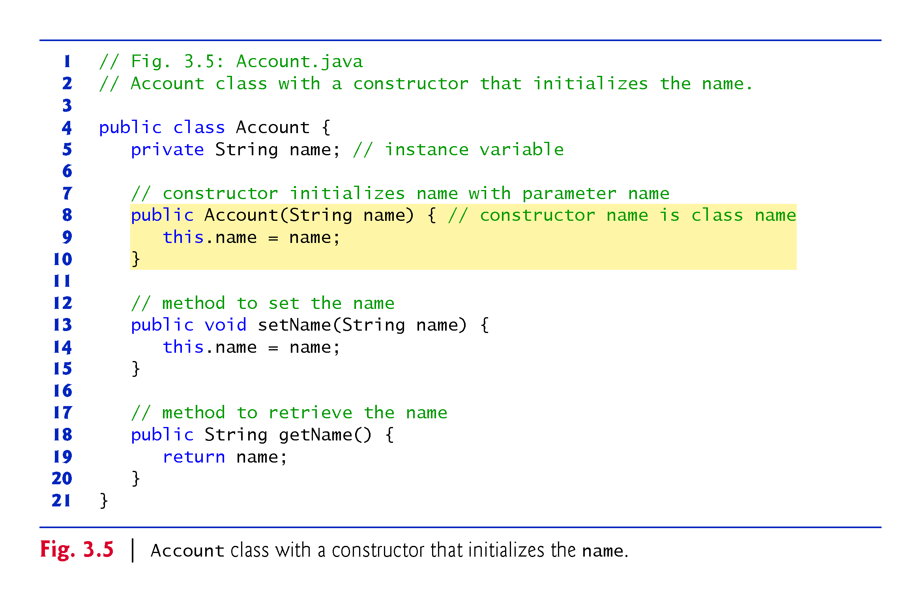

Slide 48
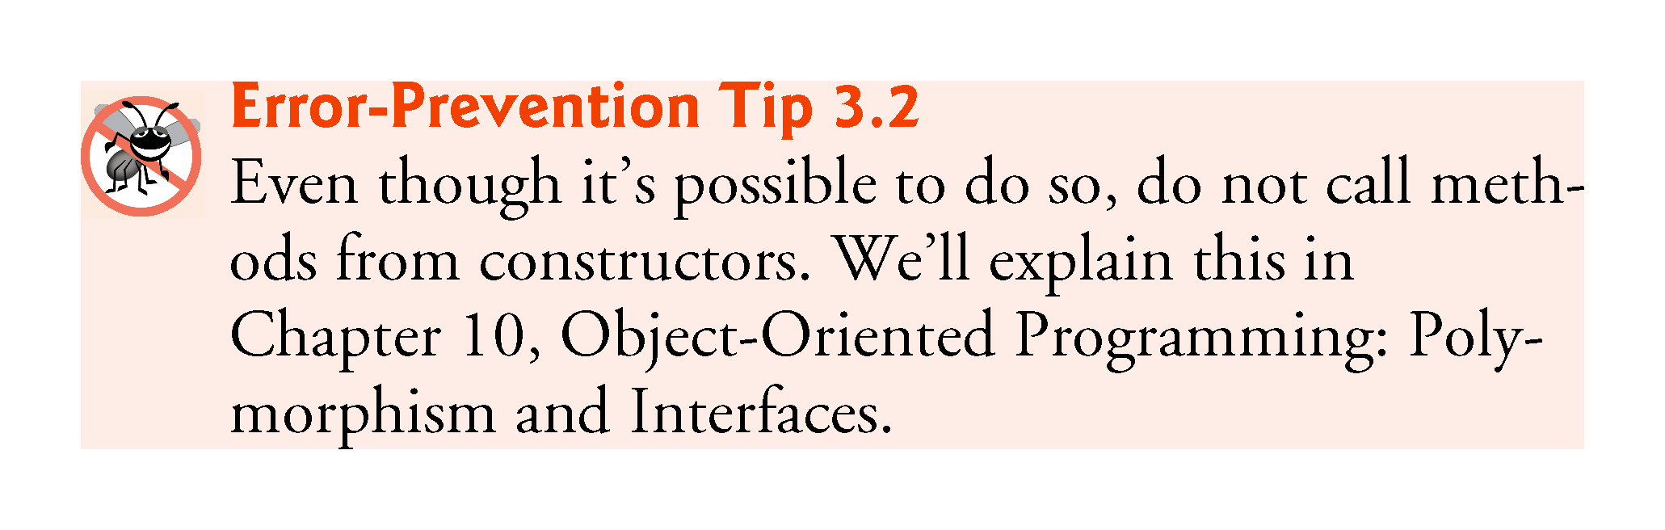

Slide 49
3.3.2 Class AccountTest: Initializing Account Objects When They’re Created
Constructors Cannot Return Values
Constructors can specify parameters but not return types.
Default Constructor
If a class does not define constructors, the compiler provides a default constructor with no parameters, and the class’s instance variables are initialized to their default values.
There’s No Default Constructor in a Class That Declares a Constructor
If you declare a constructor for a class, the compiler will not create a default constructor for that class.

Slide 50
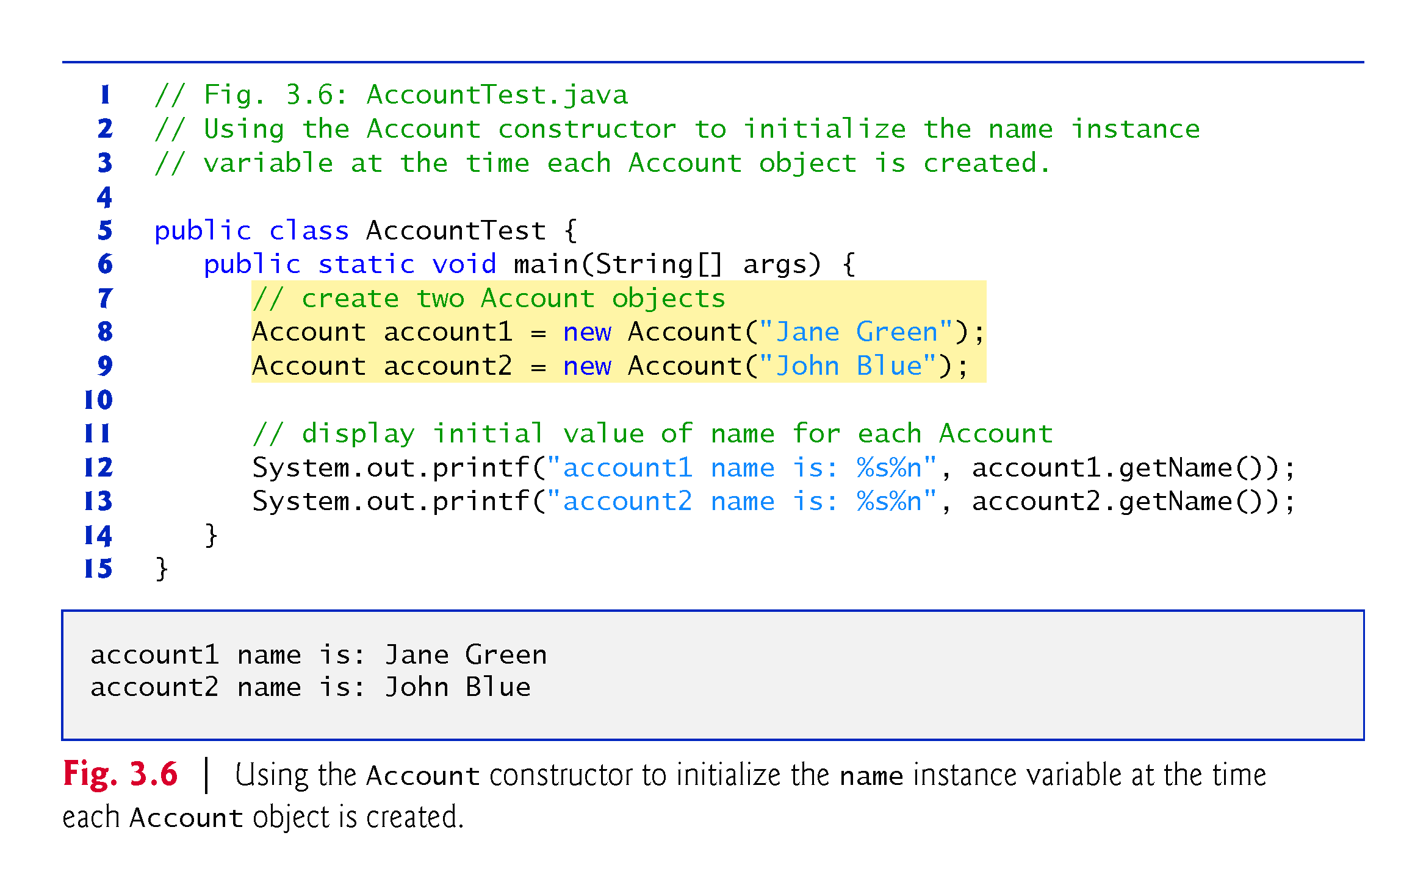

Slide 51
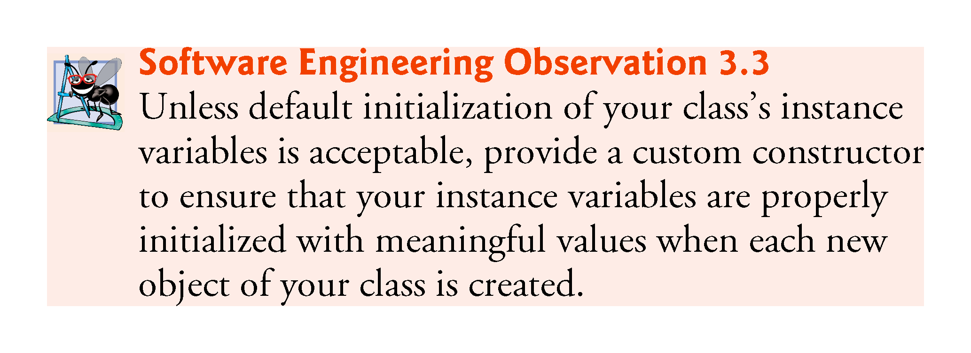

Slide 52
3.3.2 Class AccountTest: Initializing Account Objects When They’re Created (Cont.)
Adding the Contructor to Class Account’s UML Class Diagram
The UML models constructors in the third compartment of a class diagram.
To distinguish a constructor from a class’s operations, the UML places the word “constructor” between guillemets (« and ») before the constructor’s name.

Slide 53
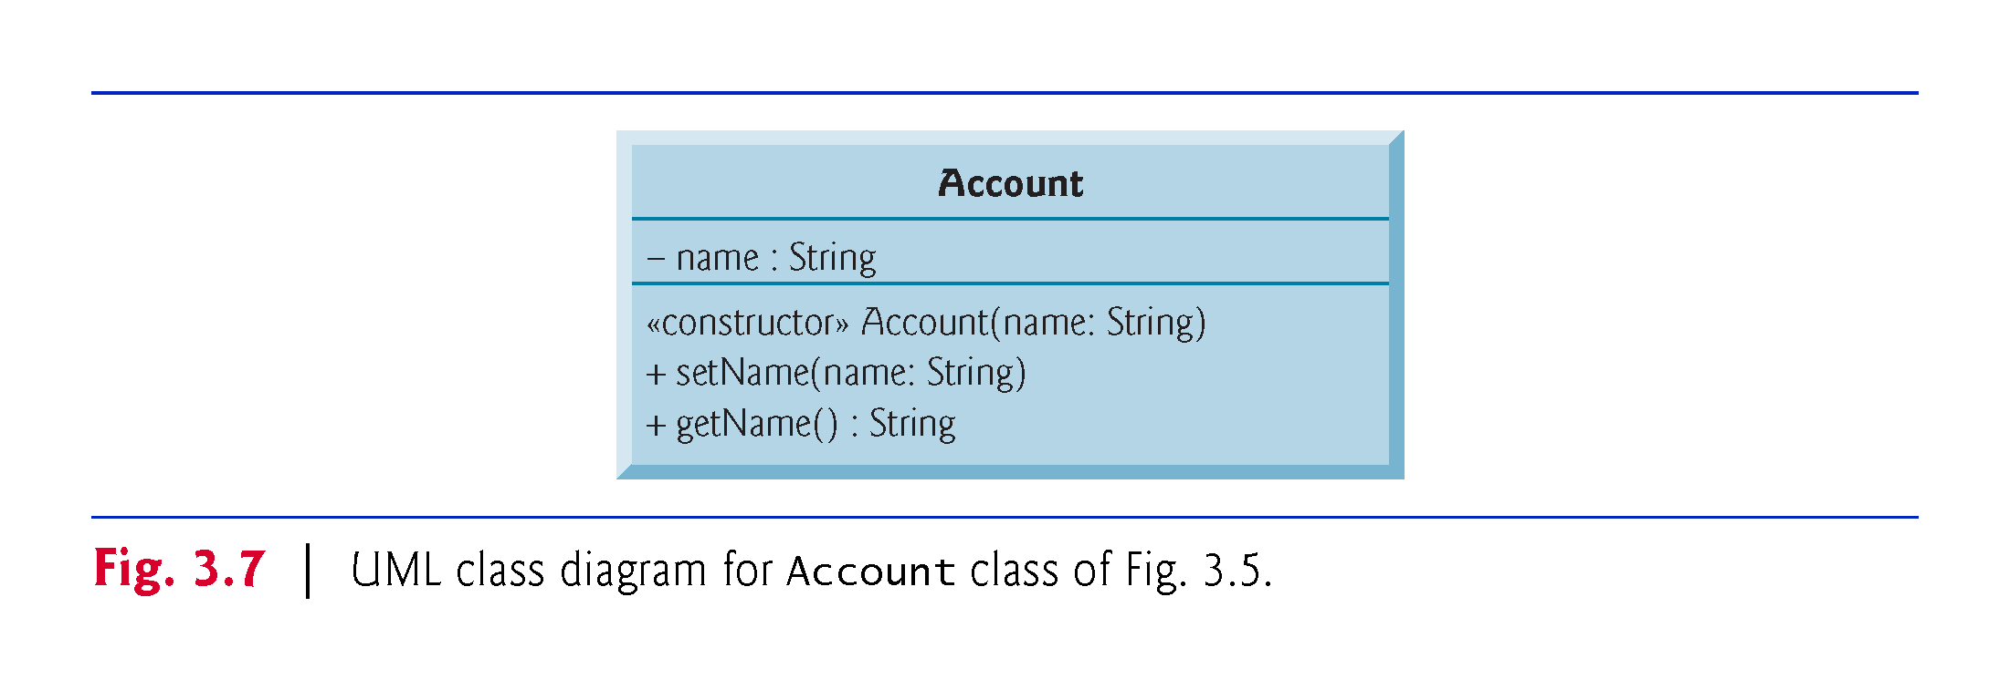

Slide 54
3.4 Account Class with a Balance; Floating-Point Numbers
A floating-point number is a number with a decimal point.
Java provides two primitive types for storing floating-point numbers in memory—float and double.
Variables of type float represent single-precision floating-point numbers and have seven significant digits.
Variables of type double represent double-precision floating-point numbers.
These require twice as much memory as float variables and provide 15 significant digits—approximately double the precision of float variables.
Floating-point literals are of type double by default.

Slide 55
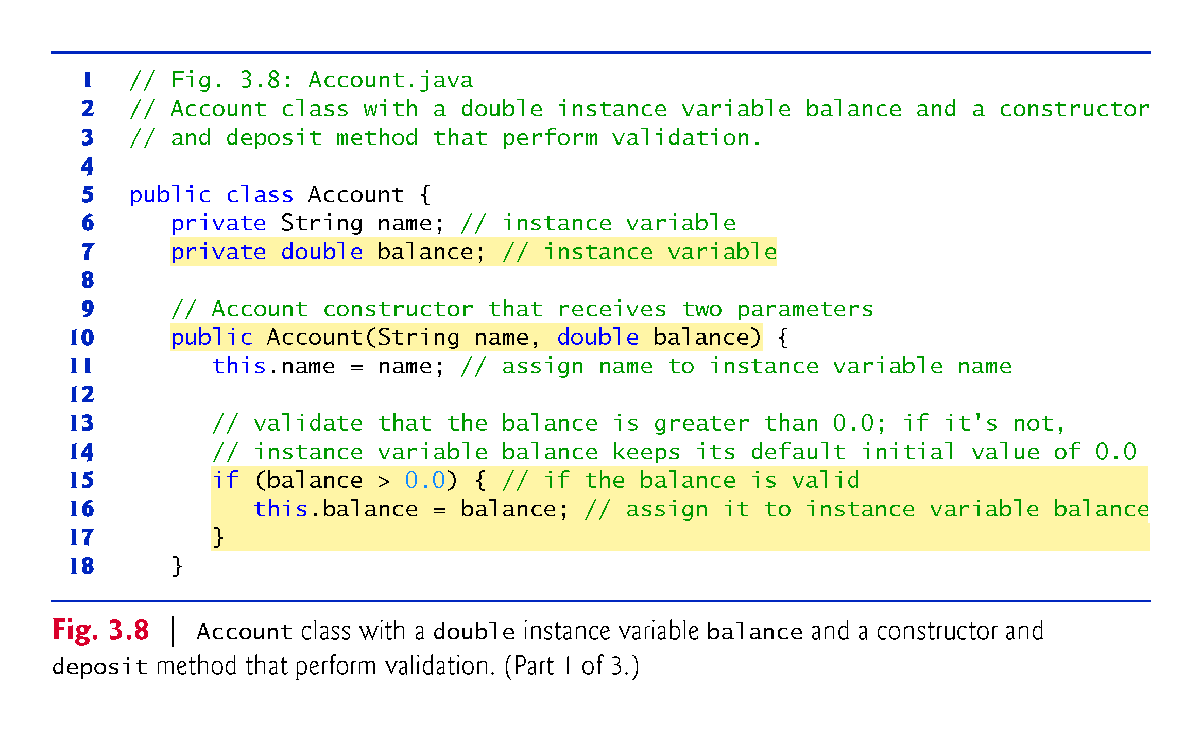

Slide 56
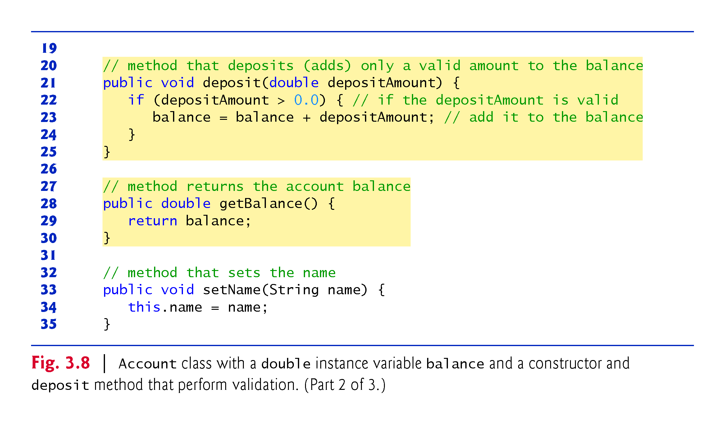

Slide 57
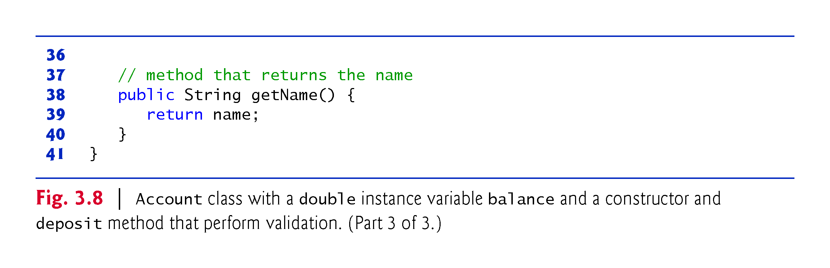

Slide 58
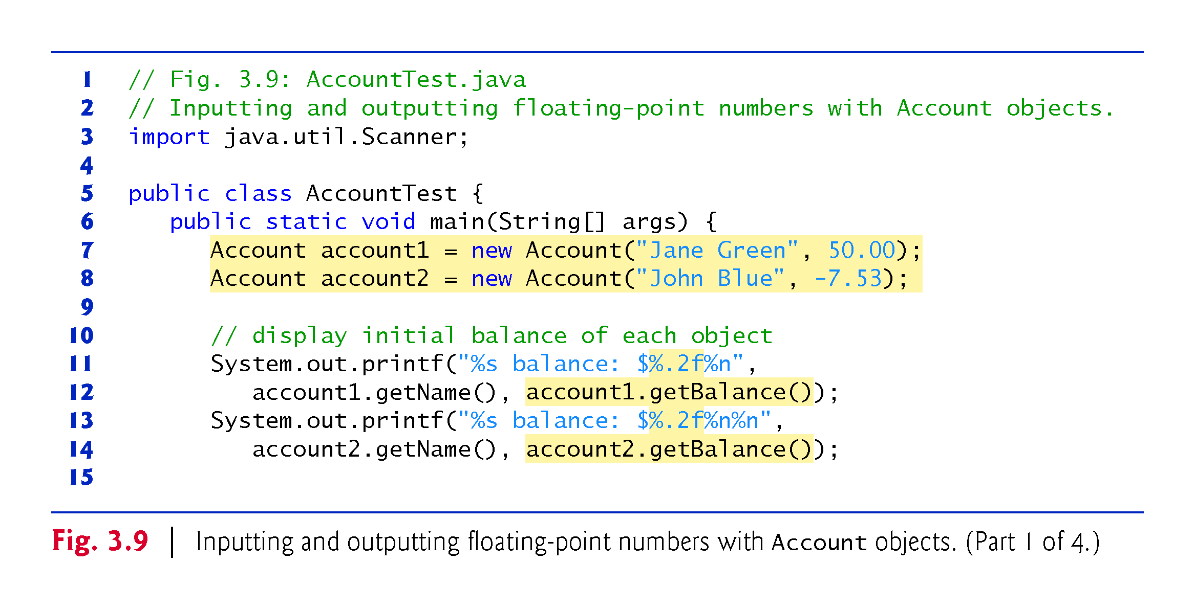
3.4.2 AccountTest Class to Use Class Account

Slide 59
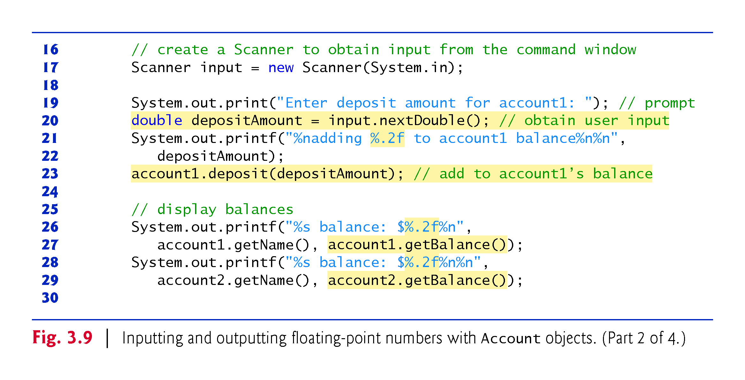

Slide 60
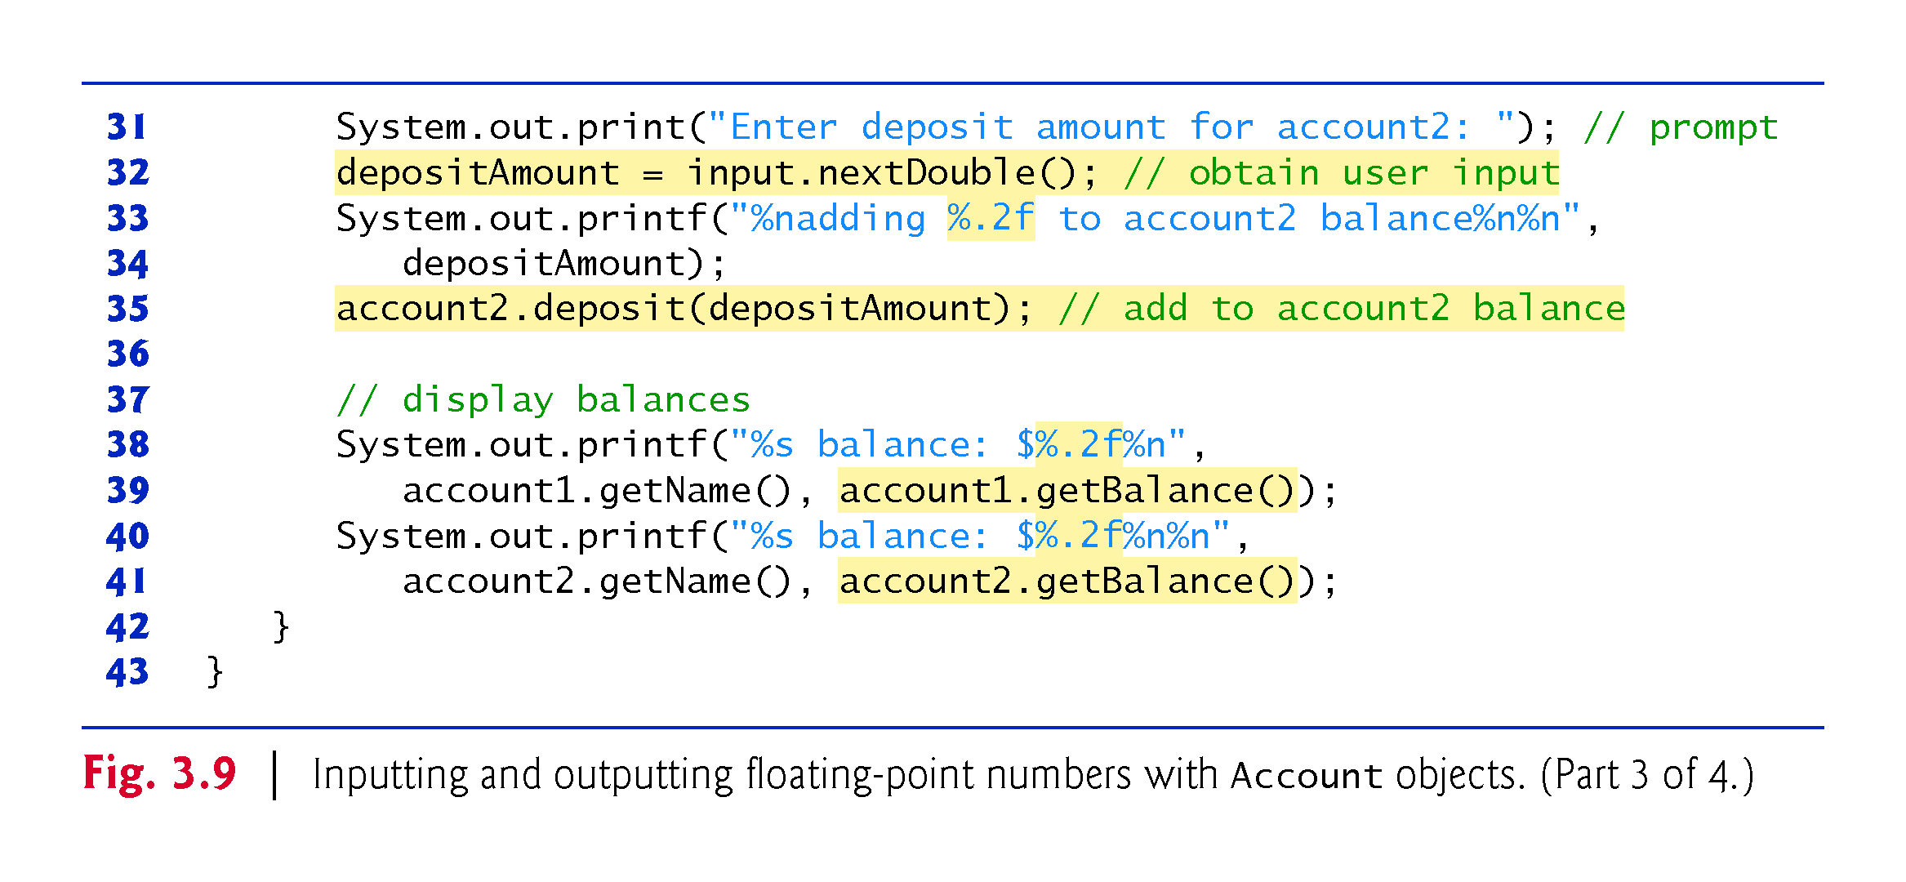

Slide 61
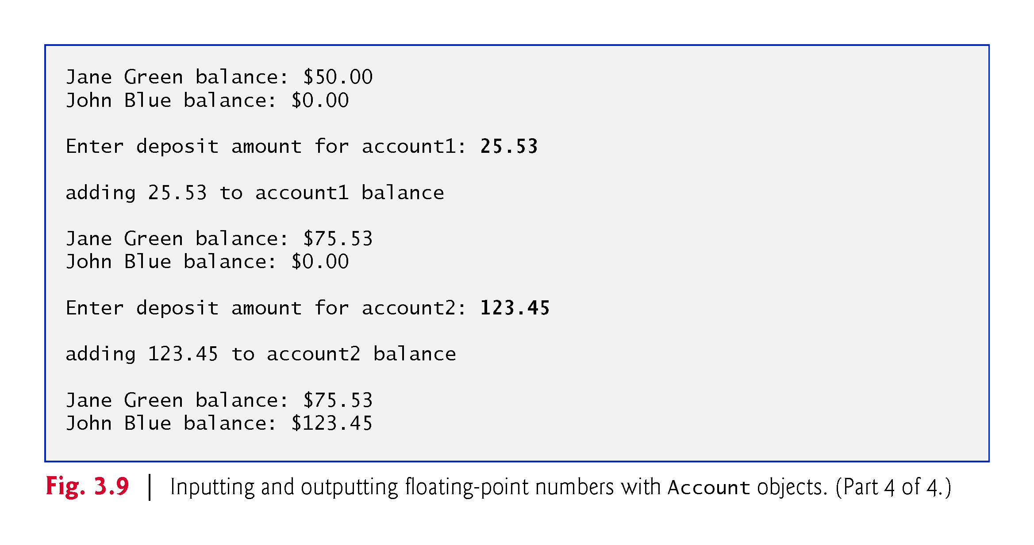

Slide 62
3.4.2 AccountTest Class to Use Class Account (Cont.)
Scanner method nextDouble returns a double value.

Slide 63
3.4.2 AccountTest Class to Use Class Account (Cont.)
Formatting Floating-Point Numbers for Display
The format specifier %f is used to output values of type float or double.
The format specifier %.2f specifies that two digits of precision should be output to the right of the decimal point in the floating-point number.

Slide 64
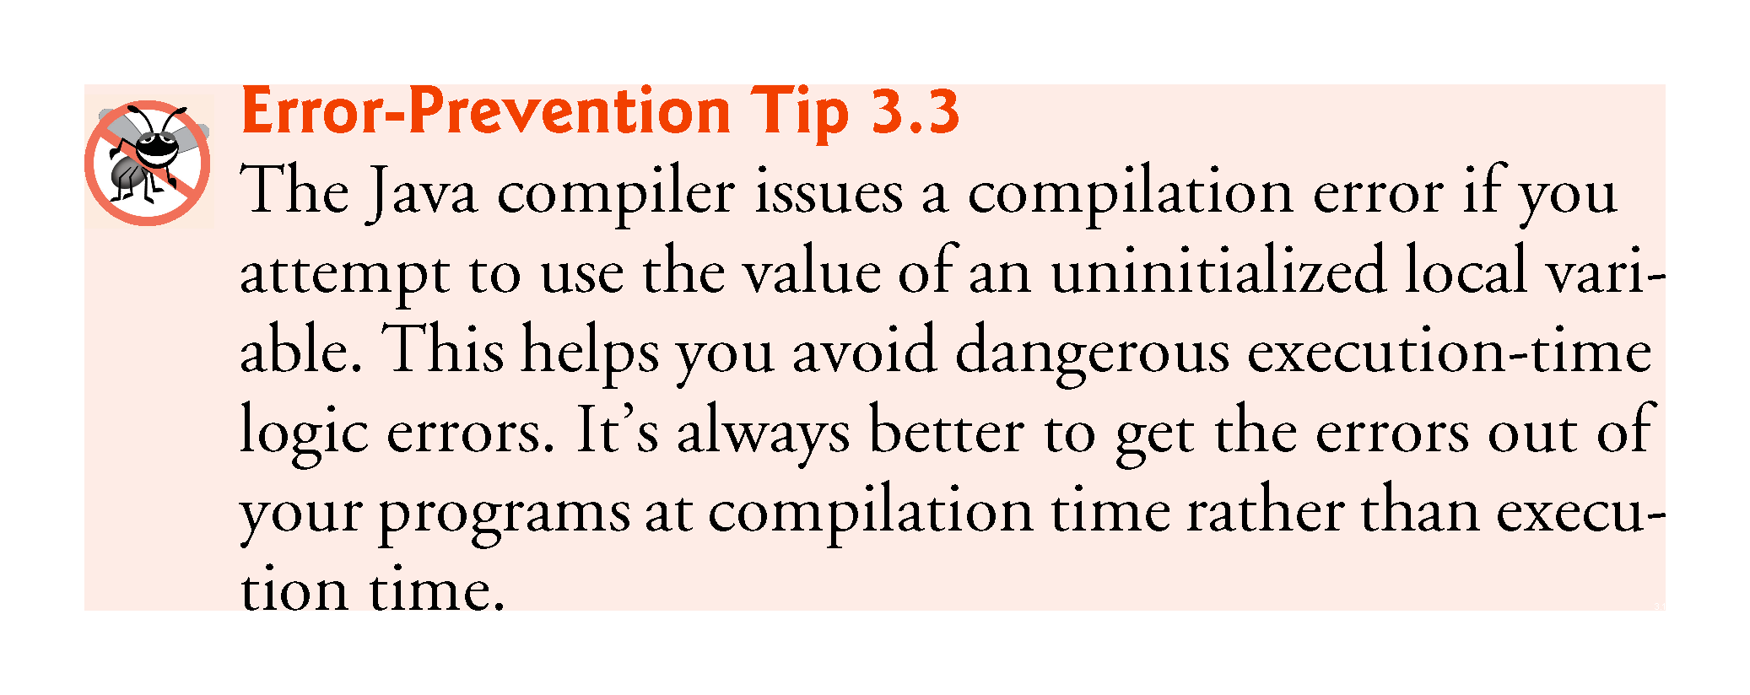

Slide 65
3.4.2 AccountTest Class to Use Class Account (Cont.)
The default value for an instance variable of type double is 0.0, and the default value for an instance variable of type int is 0.

Slide 66
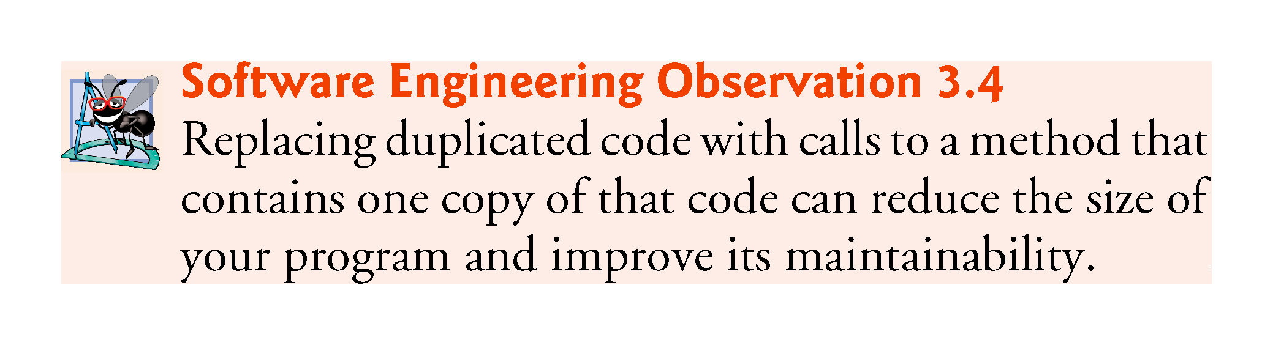

Slide 67
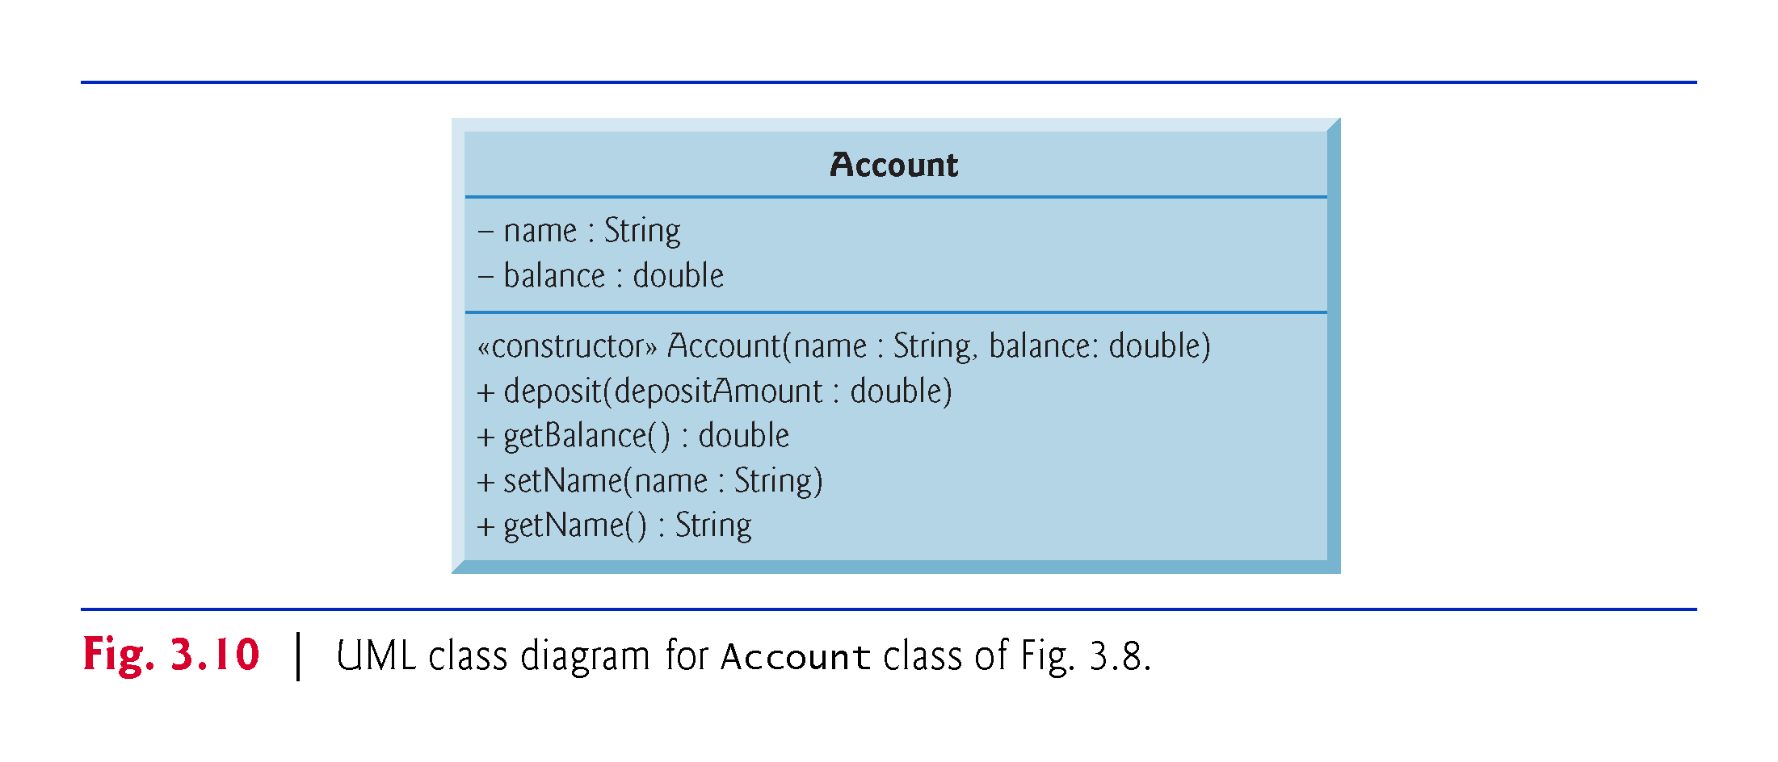

Slide 68
3.5 Primitive Types vs. Reference Types
Types in Java are divided into two categories—primitive types and reference types.
The primitive types are boolean, byte, char, short, int, long, float and double.
All other types are reference types, so classes, which specify the types of objects, are reference types.
A primitive-type variable can store exactly one value of its declared type at a time.
Primitive-type instance variables are initialized by default.
Variables of types byte, char, short, int, long, float and double are initialized to 0.

Slide 69
3.5 Primitive Types vs. Reference Types (Cont.)
Variables of type boolean are initialized to false.
Reference-type variables (called references) store the location of an object in the computer’s memory.
Such variables refer to objects in the program.
The object that’s referenced may contain many instance variables and methods.
Reference-type instance variables are initialized by default to the value null.
A reference to an object is required to invoke an object’s methods.
A primitive-type variable does not refer to an object and therefore cannot be used to invoke a method.

Slide 70
3.6 (Optional) GUI and Graphics Case Study: Using Dialog Boxes

Slide 71
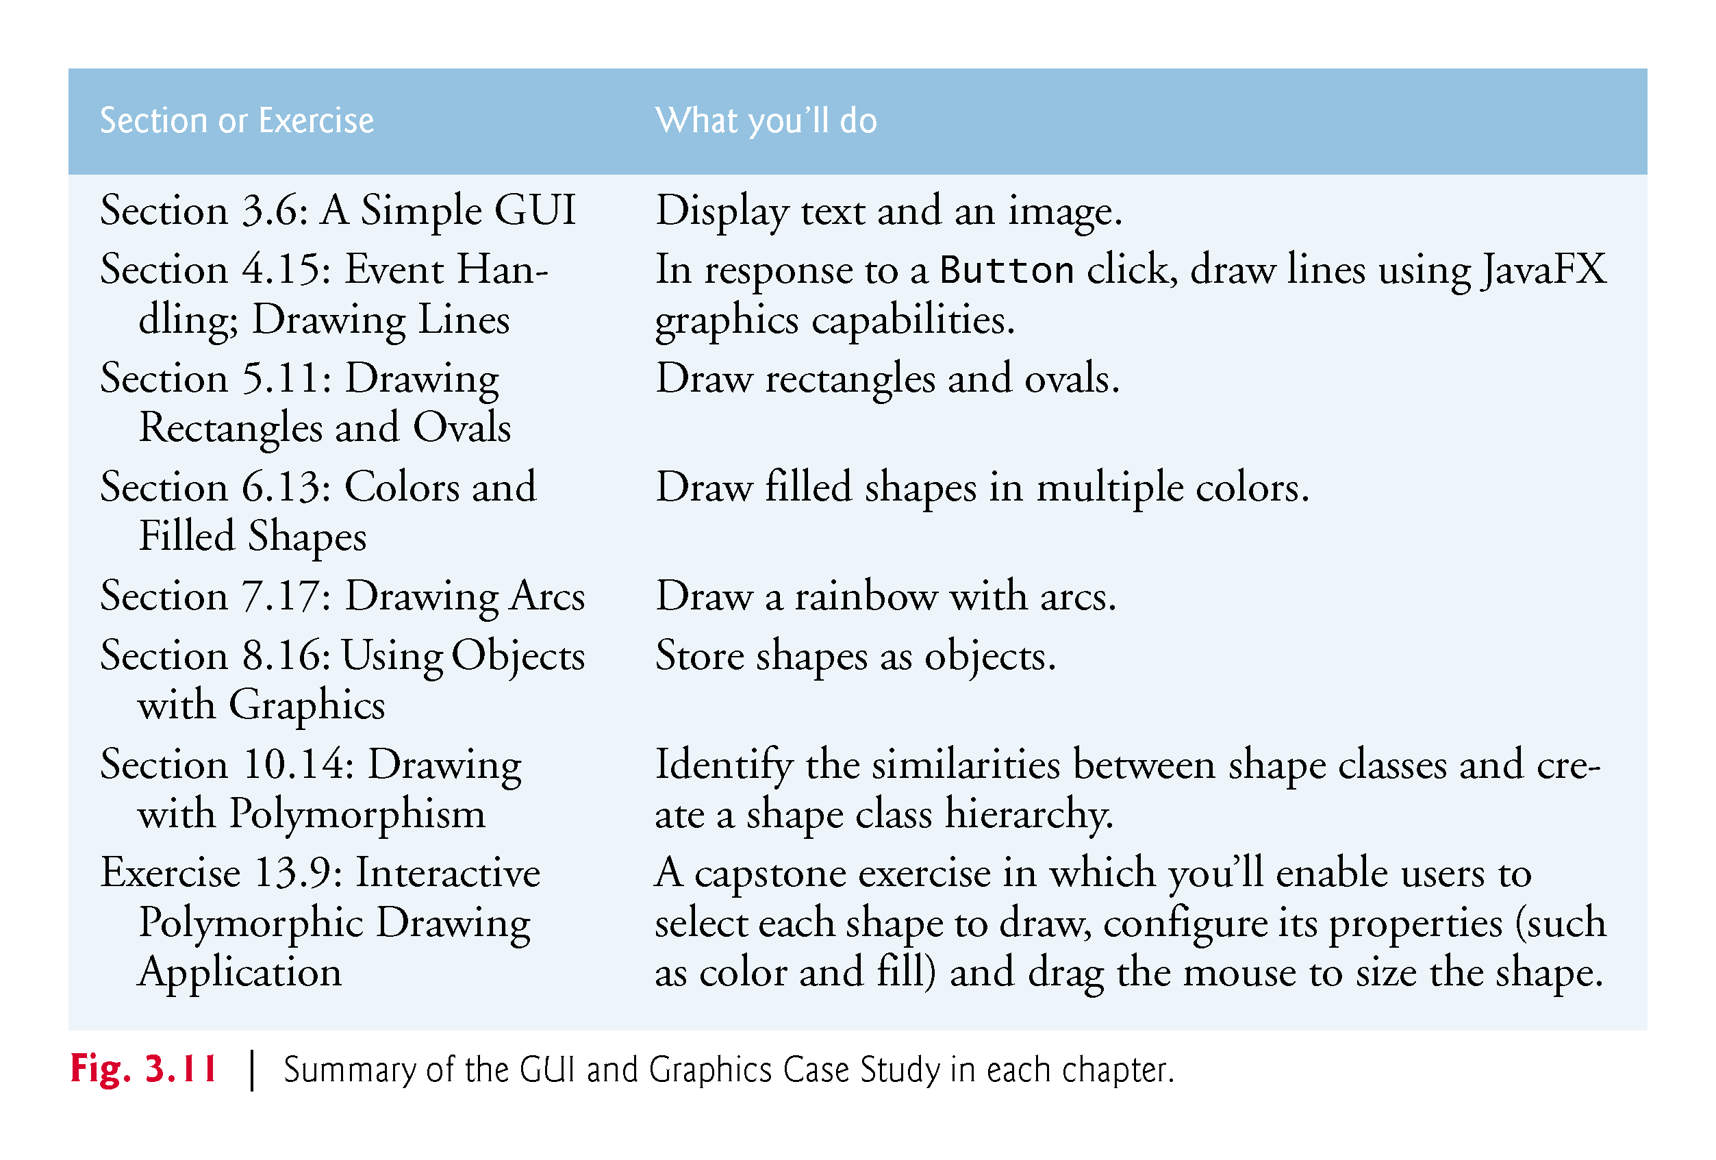

Slide 72
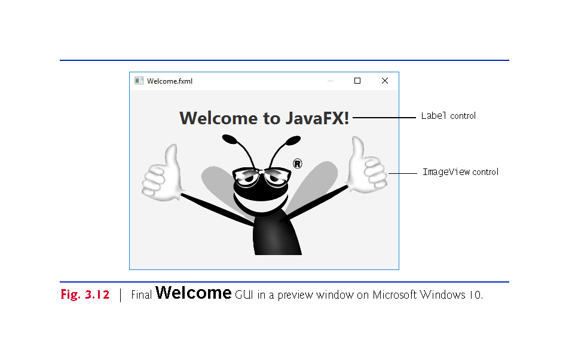

Slide 73
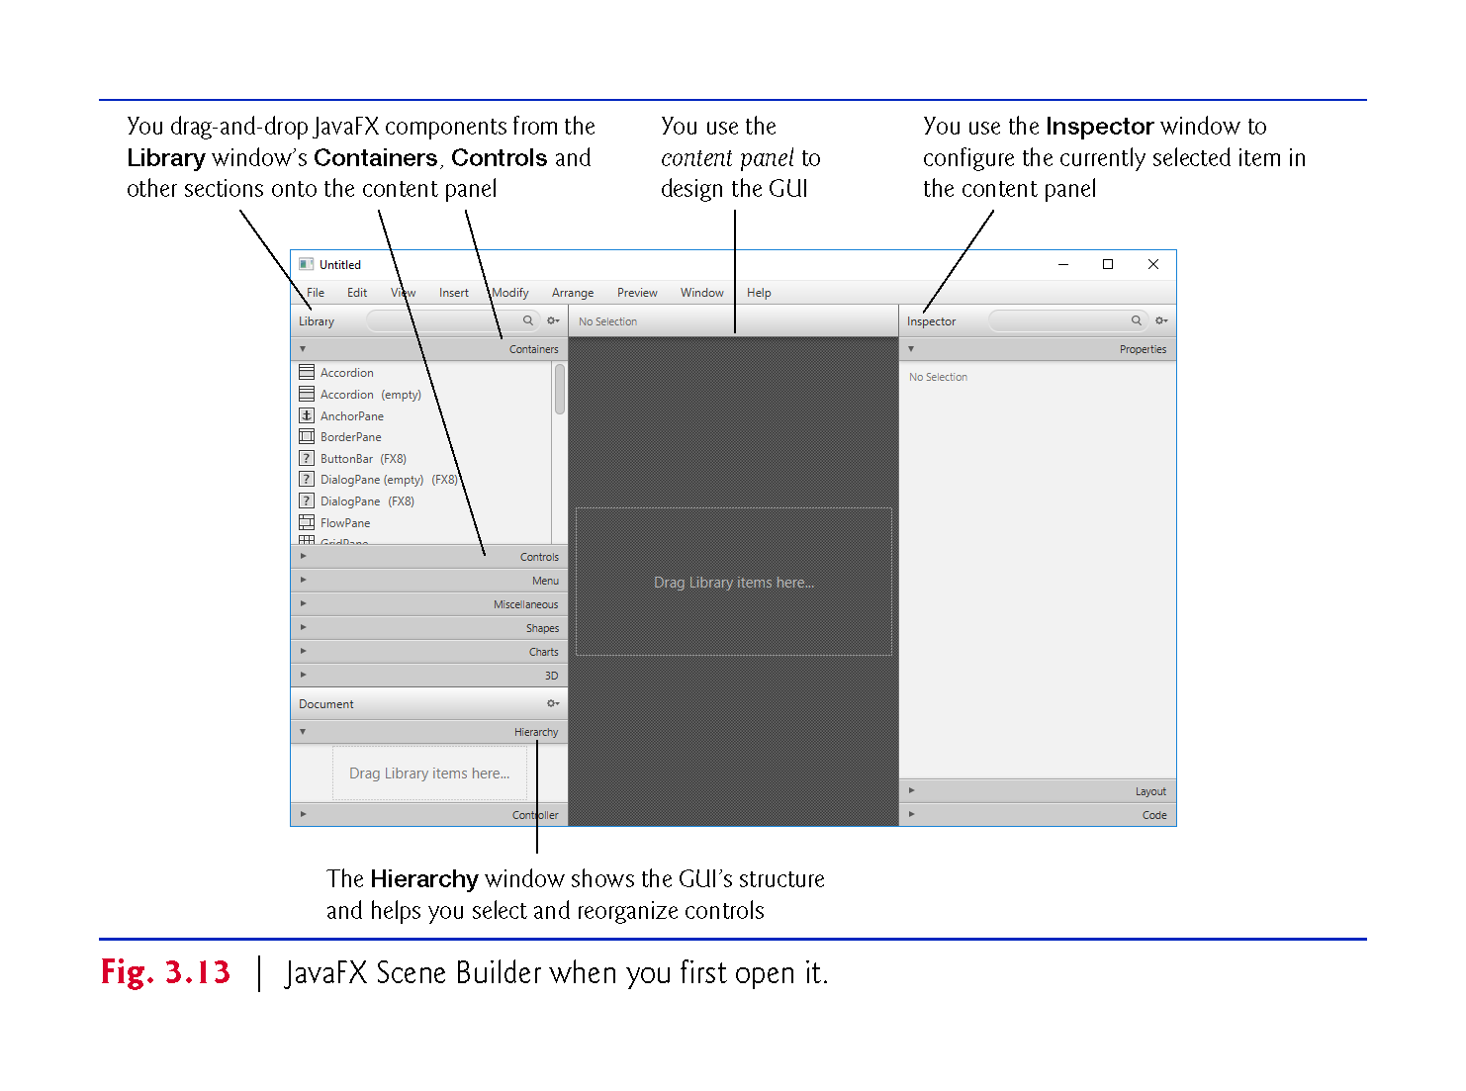

Slide 74
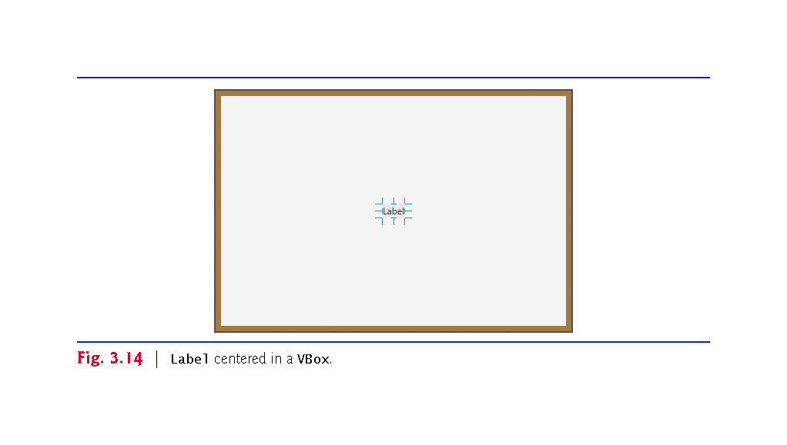

Slide 75
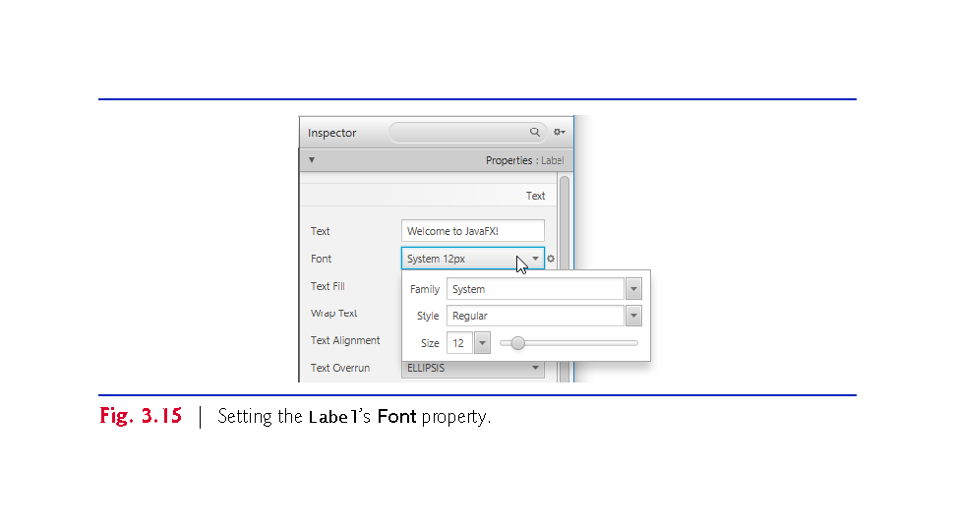

Slide 76
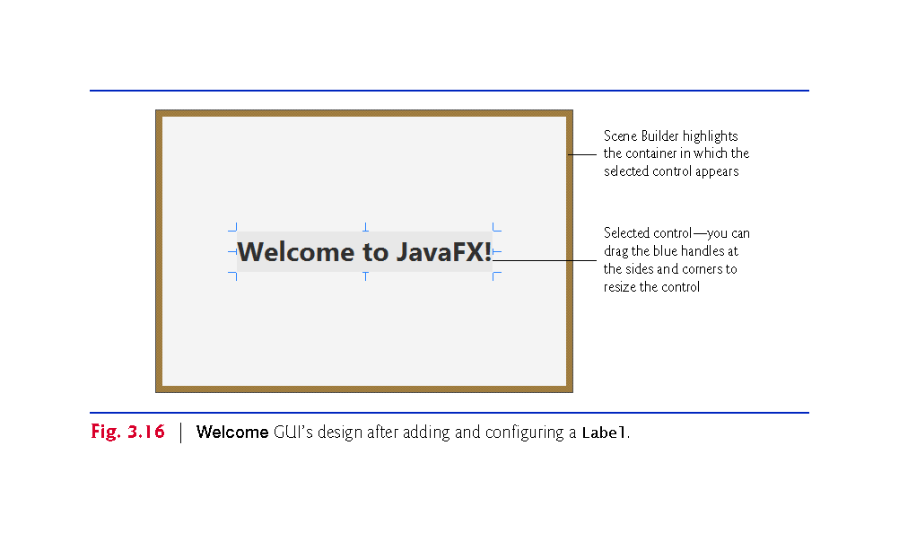

Slide 77
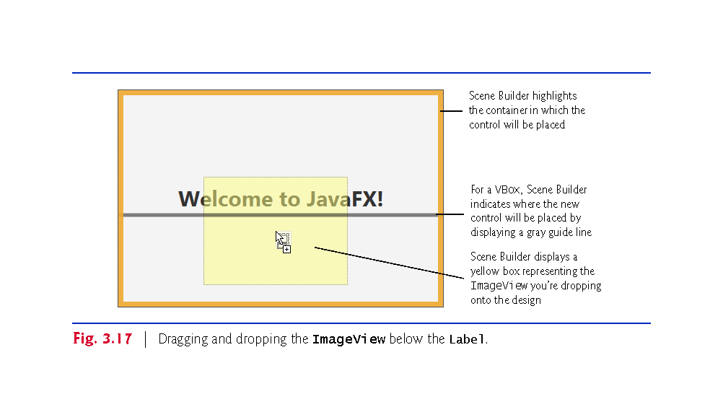

Slide 78
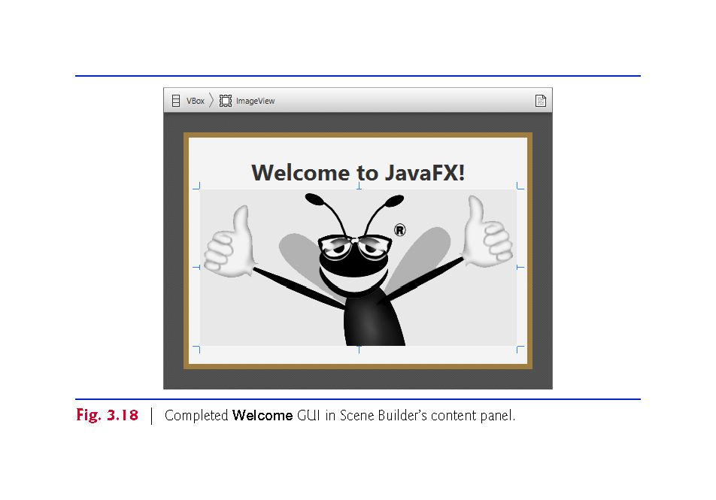

Slide 79
